Slide 2
AGGIE MOMS MEETINGS
MOST ASKED QUESTIONS
Are internships REALLY THAT important?
What percentage of companies use internships as part of full time hiring process?
If they didn’t land an opportunity at the Career Fair what should they do?
When should my Aggie start focusing on Career?

Slide 3

Career Fairs
Agriculture
Architecture
Business
Camp Day
Construction
Education
Engineering
Geosciences
Graduate and Professional School
Health Professions
Industrial Distribution
Landscape Architecture & Urban Planning
Liberal Arts
Law School Caravan
Overseas Day
Retailing
Sciences
Recreation, Park, & Tourism Sciences

Slide 4
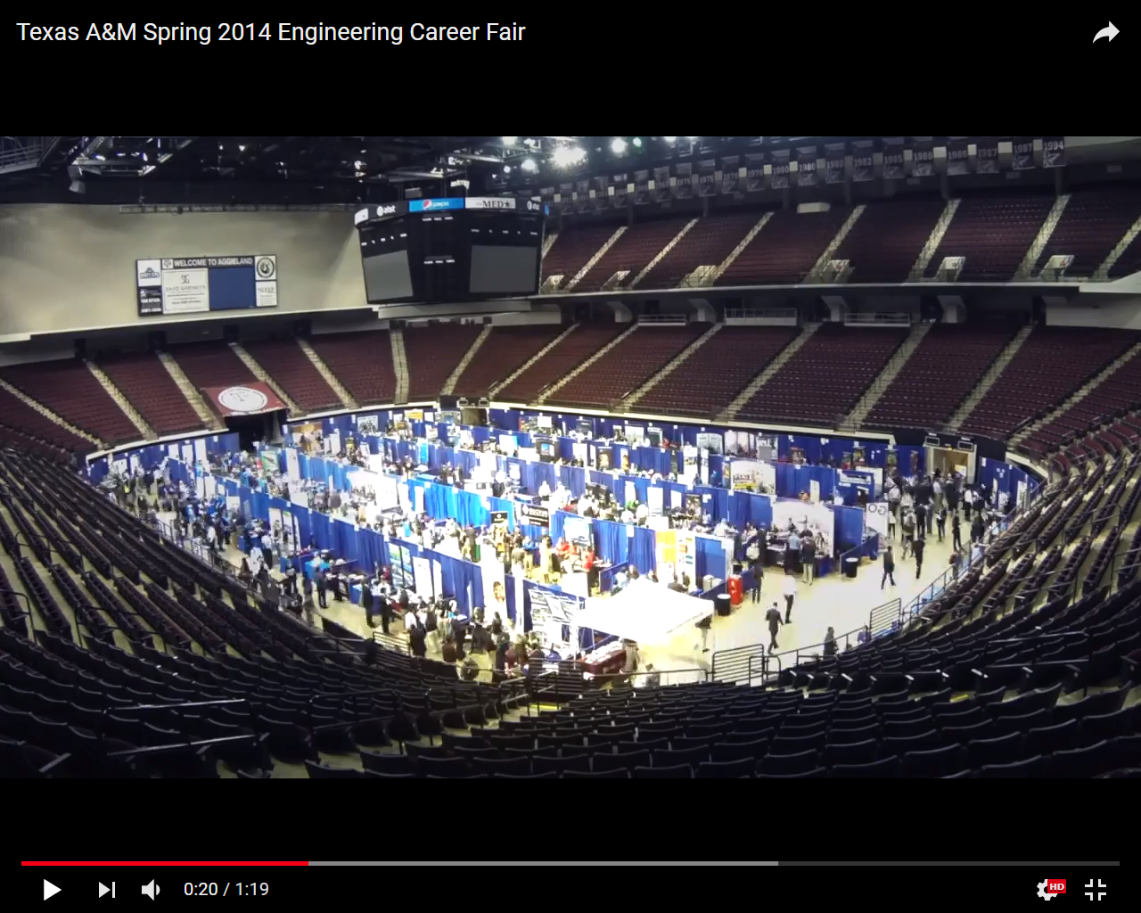

Slide 5
Timeline of key events
Jan 20
Pitch Perfect: Resume Reviews & Elevator Pitch Practice 9a-4p 209 Koldus
Resume review and feedback then practice your elevator pitch with Industry and Career Center professionals
Jan 17 -Mar 30 (20+ Career Fairs each semester)
Spring Career Fair Season https://careercenter.tamu.edu/events/career-fairs
Explore different career paths. Network with potential employers at our fairs.
Some are open to all majors with some targeting specific student groups.
Late April
Career Center / The Federation of Aggie Moms “Create Your Advantage Webinar”
Help Your Aggies focus on tuning-up their resume and learn Summer Network Strategies.
Prepare well to compete well during Fall career fair season.
Complete your Career Assessment to help focus your plans for Fall Career Fair season
FOCUS 2 ASSESSMENT at https://uhs.tamu.edu/mental-health/career-counseling.html
July 2026
Career Readiness Bootcamp Badge - Complete this on-line badge program to build your skills around career readiness. There are several required steps to complete.
August
Fall 2026 Career Fair Season

Slide 6
THINGS TO LEARN AS PART OF Career preparation
INVEST TIME TO LEARN ABOUT YOURSELF. IDENTIFY AND CONSIDER YOUR WORK INTERESTS AND WORKPLACE VALUES.
USUALLY INVOLVES SOME FORM OF CAREER ASSESSMENT – (FOCUS 2 ASSESSMENT)
https://uhs.tamu.edu/mental-health/career-counseling.html
MEET YOUR CAREER ADVISOR TO FIND AND OPTIMIZE RESOURCES IN-PLACE TO HELP YOU:
IDENTIFY INDUSTRIES AND EMPLOYERS TO EXPLORE THEIR NEEDS AND STRATEGIC GOALS
SEEK OUT INDUSTRY GROUPS AND CONTACTS TO CONFIRM WHAT YOU LEARN
UNDERSTAND THE HIRING PROCESS (ADVERTISED AND HIDDEN OPPORTUNITIES)
https://careercenter.tamu.edu/about/meet-the-team
AS YOU UNDERSTAND YOURSELF, EXPLORE YOUR ALIGNMENT WITH INDUSTRIES AND ROLES
MODIFY YOUR RESUME, PITCH AND COVER LETTER TO HELP HIRING MANAGERS
SEE THEY NEED TO TALK TO YOU BECAUSE OF THEIR PLANS
https://careercenter.tamu.edu/current-students/resources
EARN MARKETABLE EXPERIENCE THROUGH JOBS, STUDENT EMPLOYMENT, INTERNSHIPS, & CAMPUS PARTICIPATION
https://careercenter.tamu.edu/current-students/find-an-internship-job
LEARN HOW TO MEET YOUR NEXT TEAMMATES AND MANAGER
https://careercenter.tamu.edu/current-students/networking-and-linkedin

Slide 7
Career preparation Checklist
CAREER ASSESSMENT – FOCUS 2 ASSESSMENT AT
https://uhs.tamu.edu/mental-health/career-counseling.html
MEET YOUR CAREER ADVISOR
https://careercenter.tamu.edu/about/meet-the-team
Professional School Advising https://opsa.tamu.edu/contact/index.html
LEARN TO USE OUR RESOURCES (HIREAGGIES IS MUCH MORE THAN A JOB BOARD)
https://careercenter.tamu.edu/current-students/resources
EARN MARKETABLE EXPERIENCE
https://careercenter.tamu.edu/current-students/find-an-internship-job
LEARN HOW TO MEET YOUR NEXT MANAGER
https://careercenter.tamu.edu/current-students/networking-and-linkedin

Slide 8
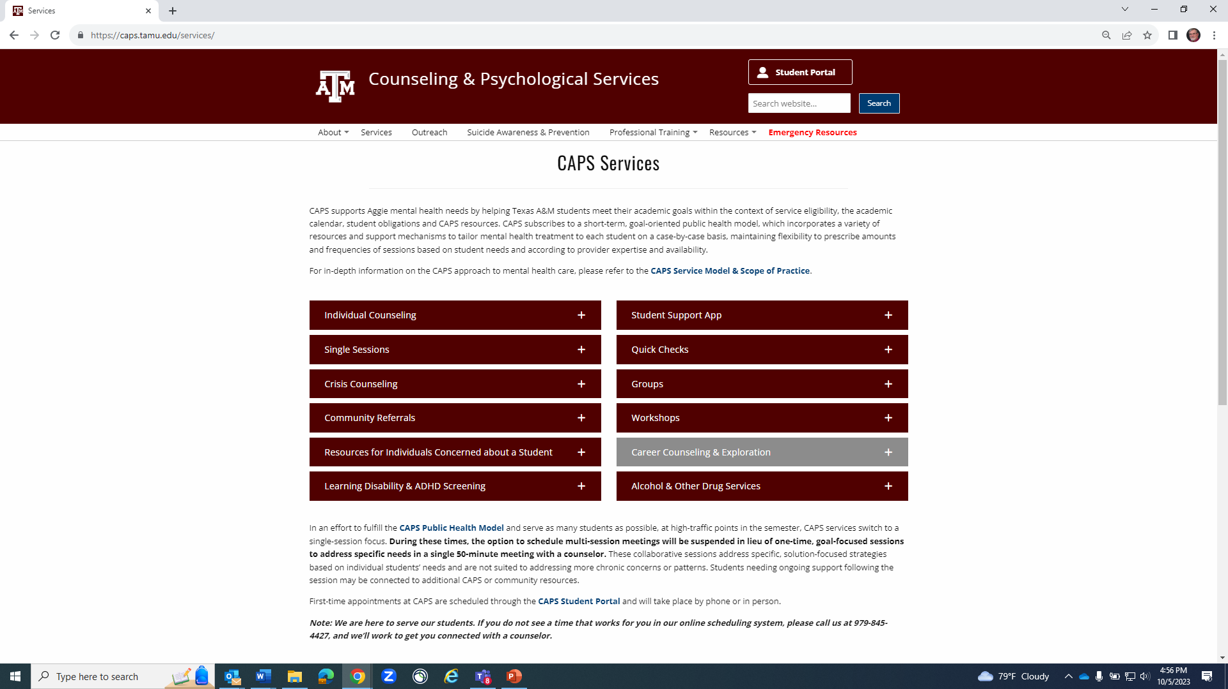
https://uhs.tamu.edu/mental-health/career-counseling.html
CAPS provides
career counseling
services to assist students in identifying the steps in their career development and exploration, which may include incorporating career assessments.
Focus 2 is a self-paced, interactive career planning program designed to help you explore college majors and plan your career based on your interests, values, skills, personality, and professional goals.

Slide 9
Core Competencies
The Top-10 Candidate Skills/Qualities Employers Seek
From “Job Outlook 2013, National Association of Colleges and Employers”
1) Ability to verbally communicate with persons inside and outside the organization
2) Ability to work in a team structure
3) Ability to make decisions and solve problems
4) Ability to plan, organize, and prioritize work
5) Ability to obtain and process information
6) Ability to analyze quantitative data
7) Technical knowledge related to the job
8) Proficiency with computer software programs
9) Ability to create and/or edit written reports
10) Ability to sell or influence others

Slide 10
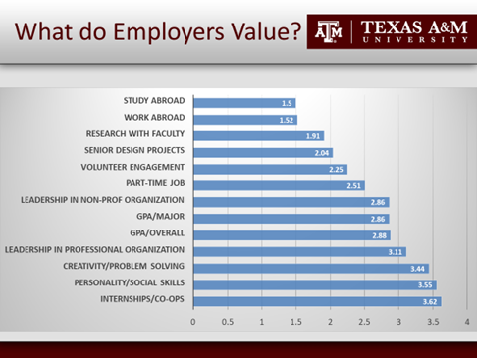

Slide 11
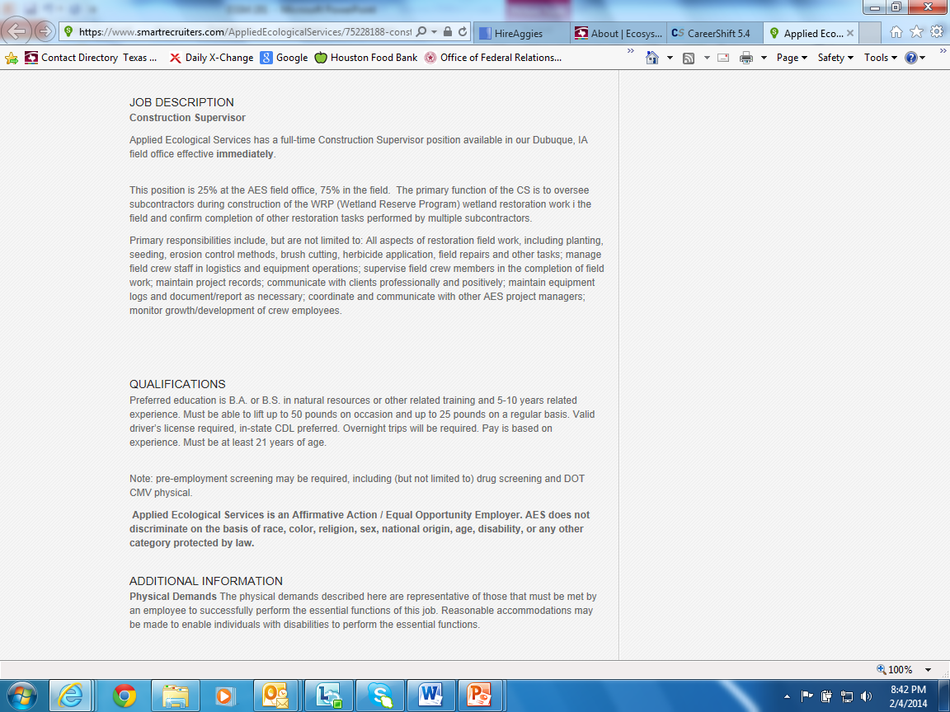
A JOB DESCRIPTION
IS AN ORGANIZATION’S
RECIPE FOR SUCCESS
FOR THAT SPECIFIC JOB.
A JOB DESCRIPTION IDENTIFIES
- REQUIRED INGREDIENTS
- HOW MUCH IS REQUIRED
- AND HOW THEY WANT YOU
TO BE PREPARED
FOR THE WORK REQUIRED

Slide 12
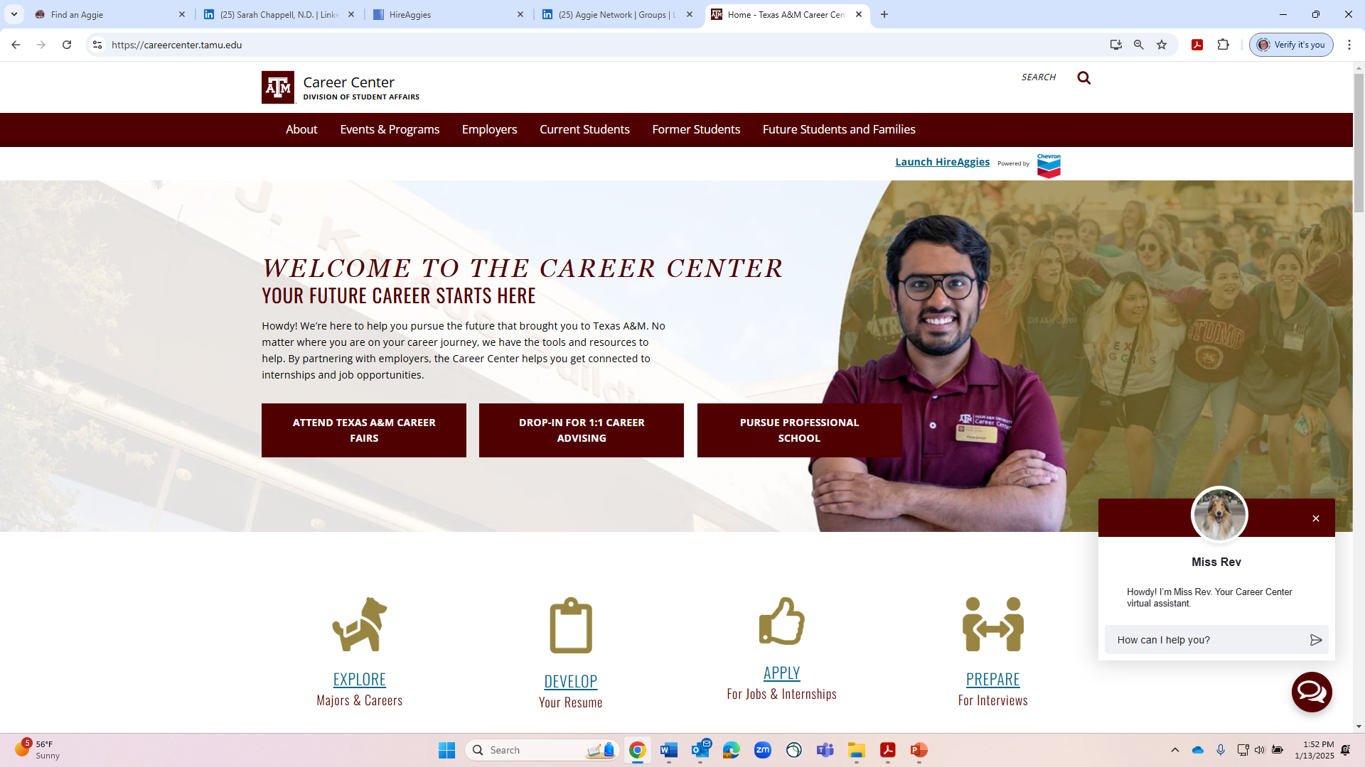

Slide 13
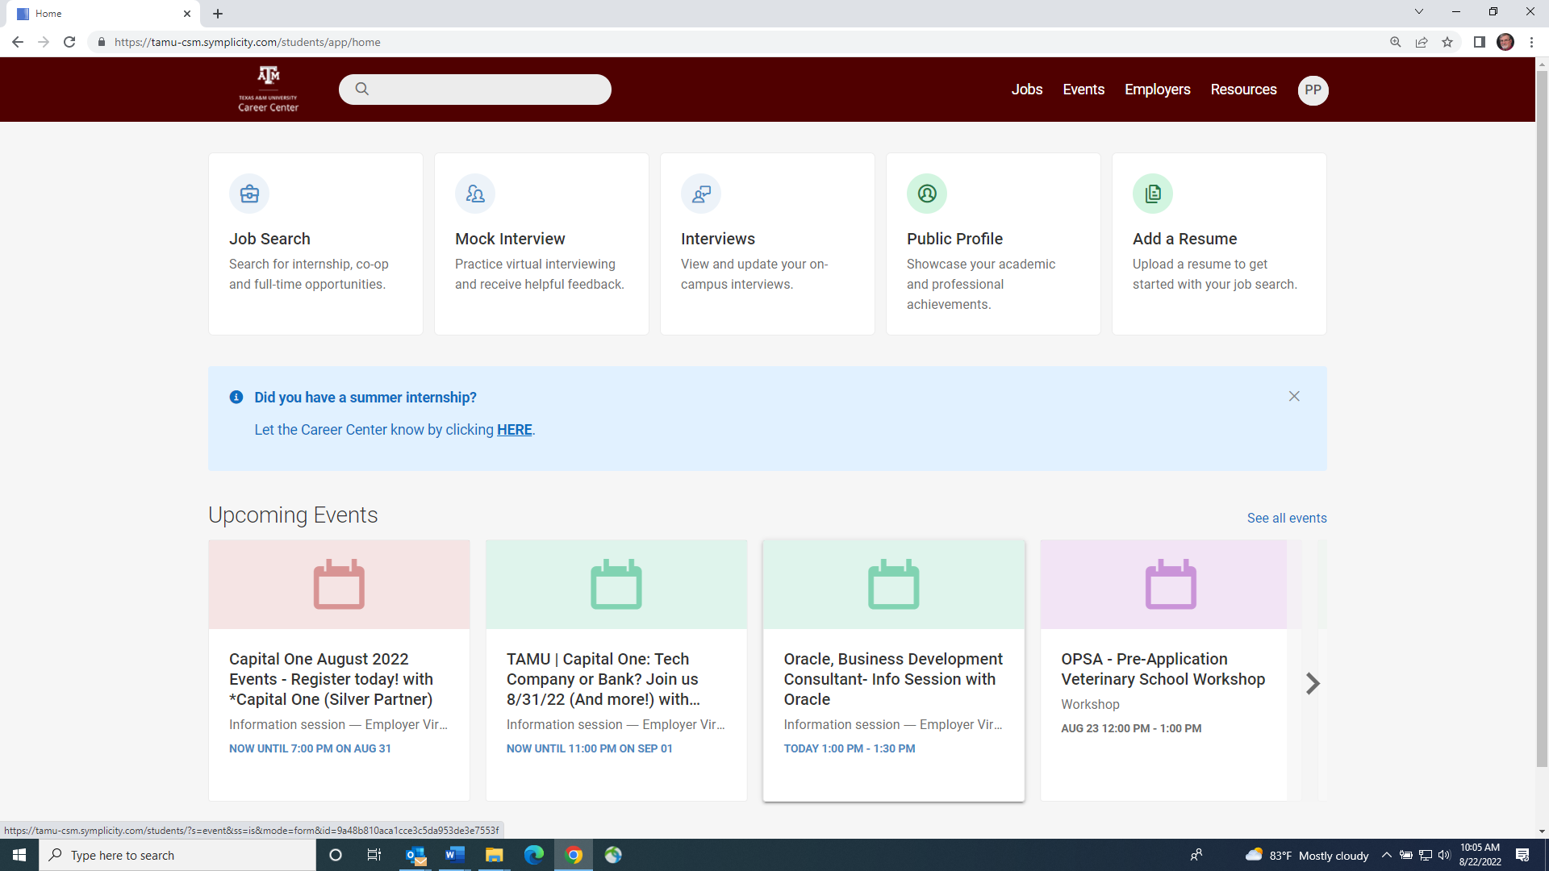
Have you explored the wealth of information
Hidden under the resources link?

Slide 14

The Jobs Link provides postings from Employers specifically posting jobs that are seeking to Hire Students or Former Students
The Employers Link identifies 4,100+ Organizations
working directly with the TAMU Career Center to find the talent and experience to build their Teams
The Resources Link provides a platform for multiple resources specifically selected to help Aggie Careers
MOCK INTERVIEWS Practice Interviews
CAREER FINDER Identify Career Interests
CAREER EXPLORER Explore Job Descriptions
SIGI3 ASSESSMENT Career Assessment Tool
CAREER INSIDER INFO Industry & Career Guides
BY FIRSTHAND Insider Info and Tips
CAREER CENTER VIDEOS Our YouTube collection
GOINGLOBAL US City and International
Resources and H1B database
CAREERSHIFT More Resources Than Linkedin
+ Provides e-mail and Phone#s

Slide 15

Career Education Workshops
CO-OP Orientation
Resume Writing
How to “Work” Career Fairs
Job & Internship Search Strategies
Behavioral Interviewing Skills
Mock Interviews & Interview Coaching
The Company Visit Interview
Salary Evaluation/Negotiation
Business Ethics
Dress for Success & Dining Etiquette
Federal Employment Forum
Applying to Graduate School
I’ve Got the Job! Now What??

Slide 16

Career Development Websites
Air Jobs
CareerShift
Eco Jobs
Going Global
Internships.com
Internships USA
Virtual Mock Interview
Jobweb
Oil & Gas Journal
SIGI³
Sports Job Board
UniWorld
Vault (Career Insider)
WetFeet.com
Washington Information Directory

Slide 17

Professional School Advising
Advises students to be competitive candidates when applying to professional schools:
  Medical
  Dental
  Physical Therapy
  Physician Assistant
  Nursing
  Law
  Pharmacy
  Veterinary Medicine

Slide 18
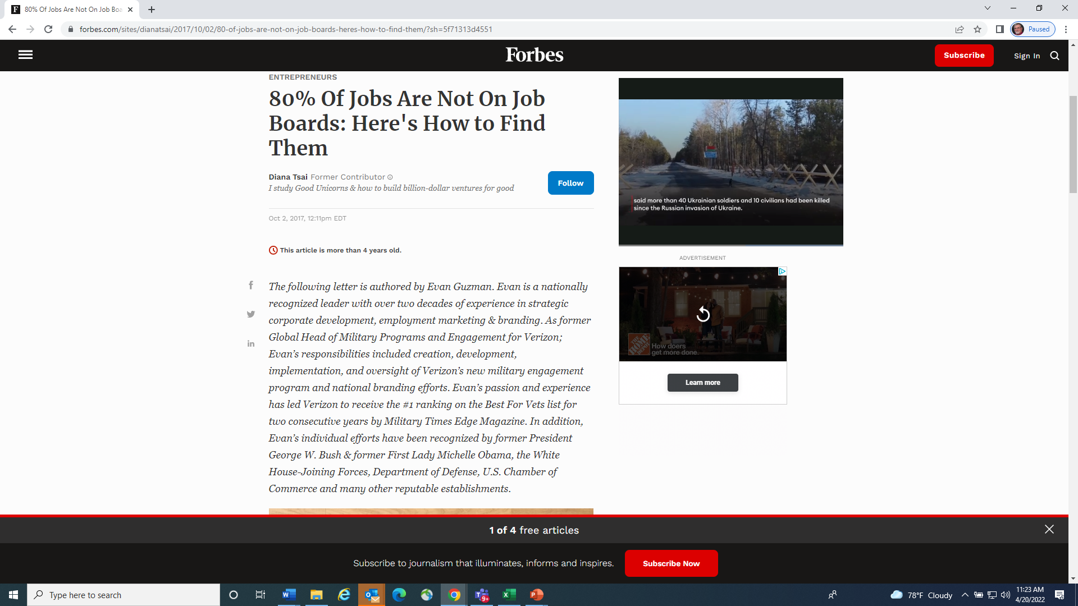

Slide 19
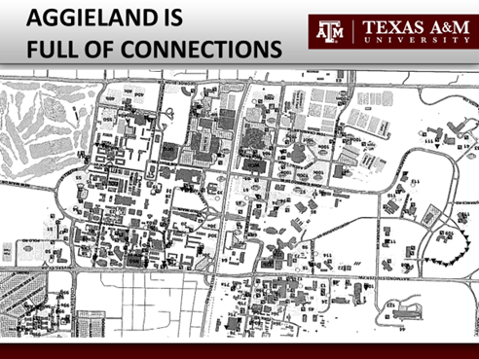

Slide 20
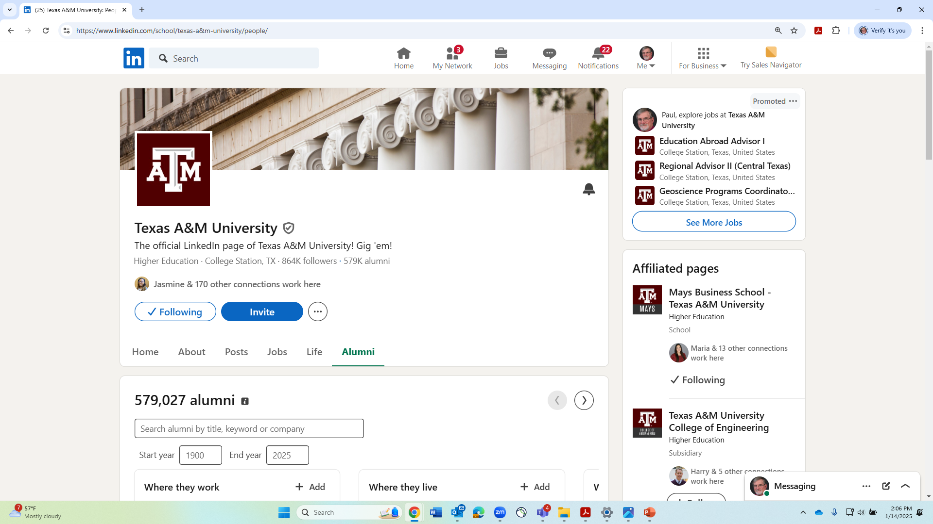
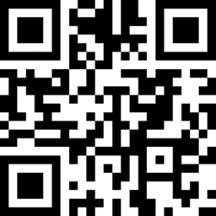
Search for Aggies By:
Where They Work
What They Do
Where They Live
What They Studied
Workplace Strengths
Search for Aggies By:
Where They Work
What They Do
Where They Live
What They
Studied
Workplace
Strengths

Slide 21
(Good Morning/Good Afternoon) Mr/Ms/Dr____________
My name is ____________. I am student at Texas A&M working to earn a degree in ____________ . While exploring career options and Aggie Network resources, I saw that your work is in (line of work). Would you have a moment to share some of your perspectives and insights regarding your work experience to help me confirm
what I am learning regarding existing and evolving needs in your field and your industry to help best prepare to compete in the marketplace?
Thank You for your assistance
Your Name Phone #
Informational Interview Questions
1. How did you get to where you are today?
2. If you were starting your career today, what would you do differently?
3. Where do you see opportunity areas, needs?
4. What characteristics/skills make for a good _________?
5. How would you describe the culture of your organization?
6. Do you know anybody that needs help?

Slide 22
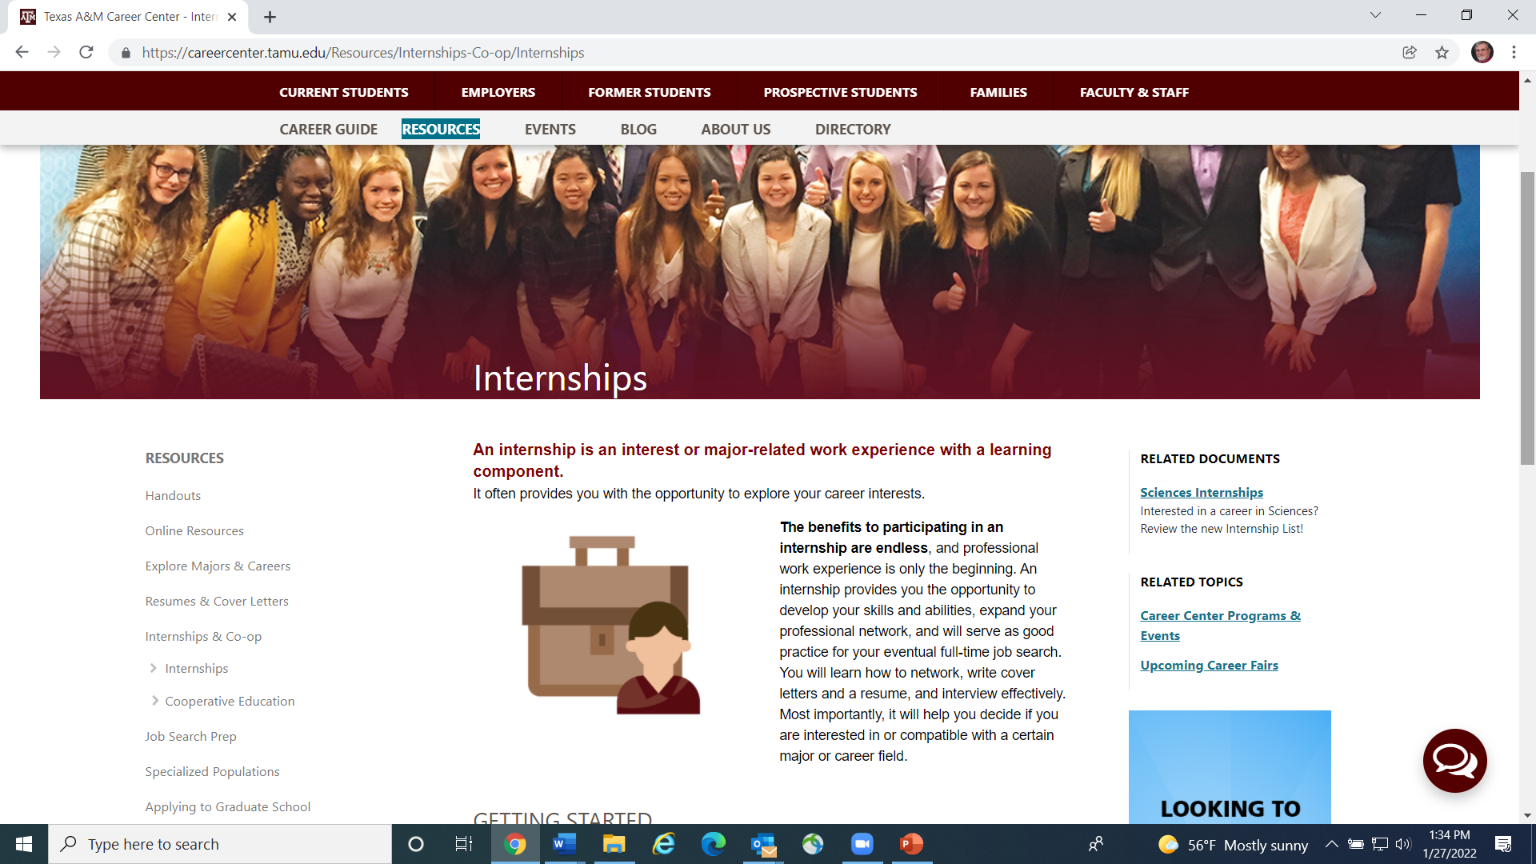
Internship Opportunities

Slide 23
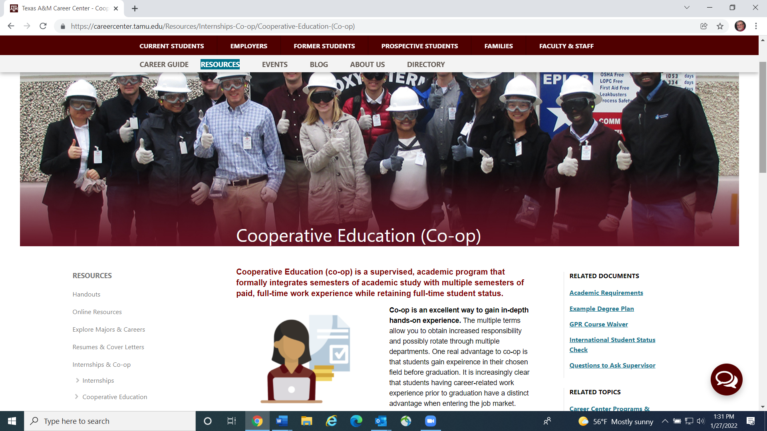
Co-op Opportunities

Slide 24
WEB RESOURCES
YOU SHOULD CONSIDER
caps.tamu.edu/career-counseling/ career assessment *
LINKEDIN.COM groups Texas A&M companies
AGGIENETWORK.COM find an aggie clubs (HireAggies link for ol’ Ags)
HIREAGGIES (ACCESSED THROUGH AGGIENETWORK.COM)
(RESOURCES LINK INCLUDES CAREERSHIFT, GOINGLOBAL, FIRSTHAND & MOCK INTERVIEW APPS)
CAREERCENTER.TAMU.EDU
JOBHUNTERSBIBLE.COM
JS101.ORG
JOBSCAN.CO (NOT .COM)
SEC.GOV (TO RESEARCH PUBLICALLY TRADED U.S. CORPORATIONS)
* BEFORE GRADUATION

Slide 25
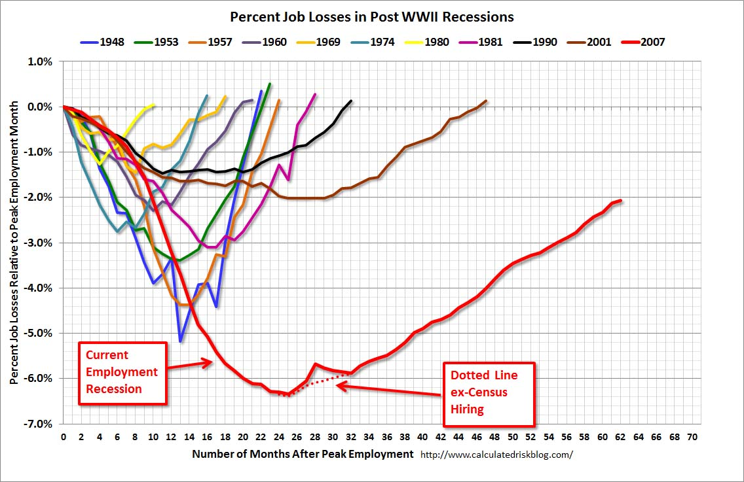


Slide 26
TURNING KEY SELECTION
TRAITS INTO JOBS
Integrity
Initiative Each trait rated on a
Enthusiasm scale of 1 to 10
Involvement to select top prospect
Confidence
Motivation
Leadership
Technical Skills

Slide 27
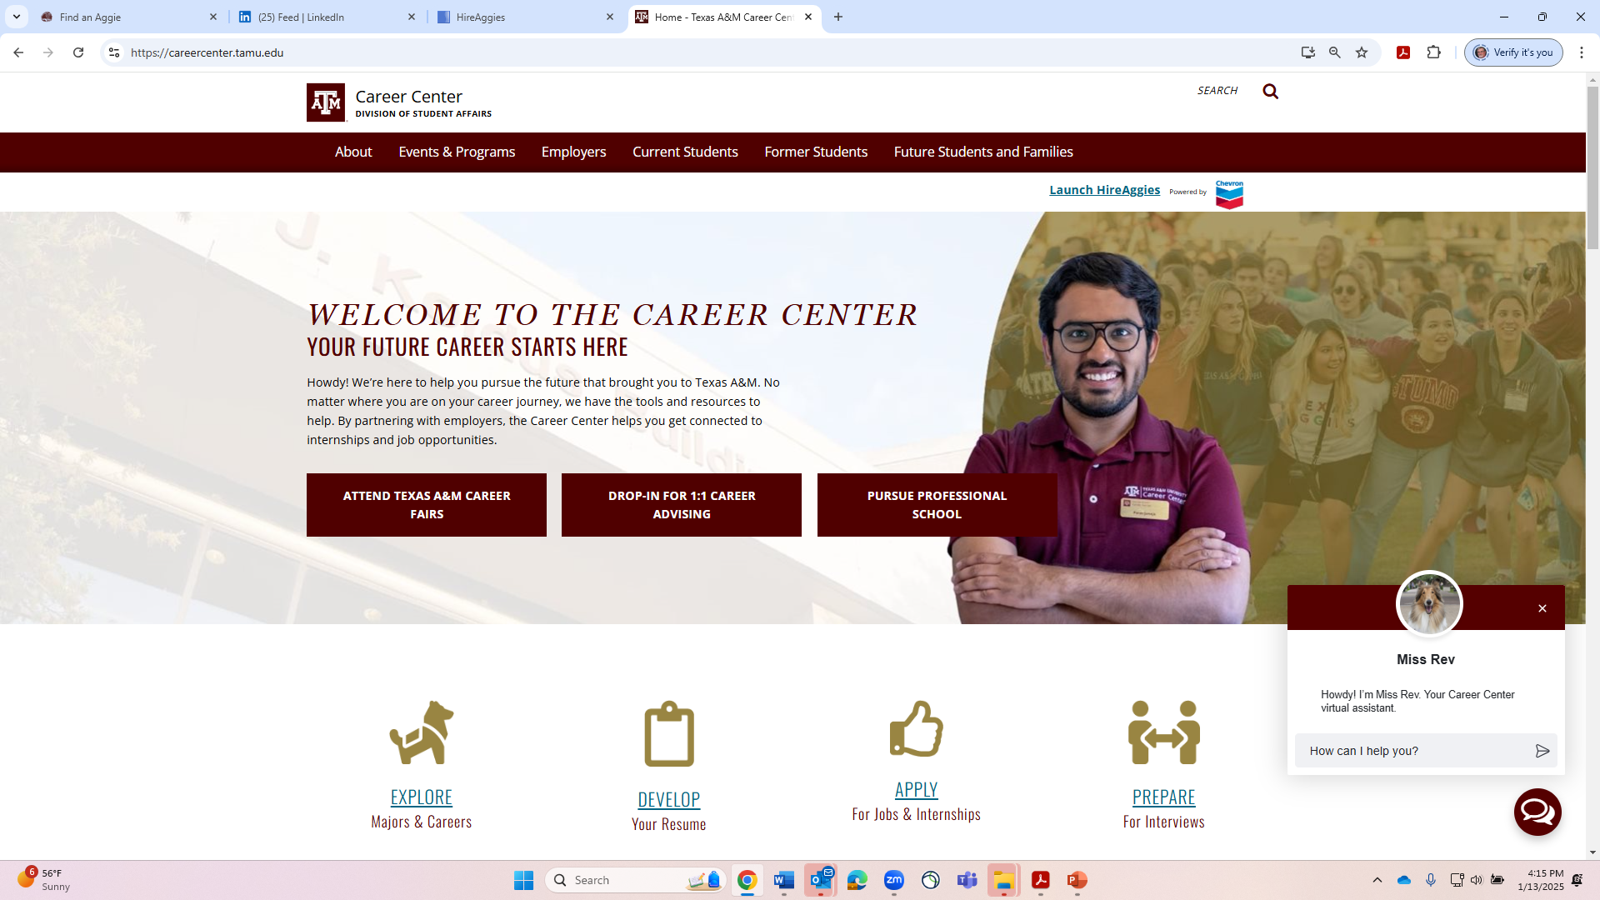

Slide 29
Zoom Meeting for Students and Former Students
From
“Good To Great”
by Jim Collins
How can I earn income?
What is my passion?
purpose?
What can I be best in the world at?

