Slide 1

Cypress Texas A&M University
Mothers’ Club
October 13, 2025 General Meeting

Slide 2
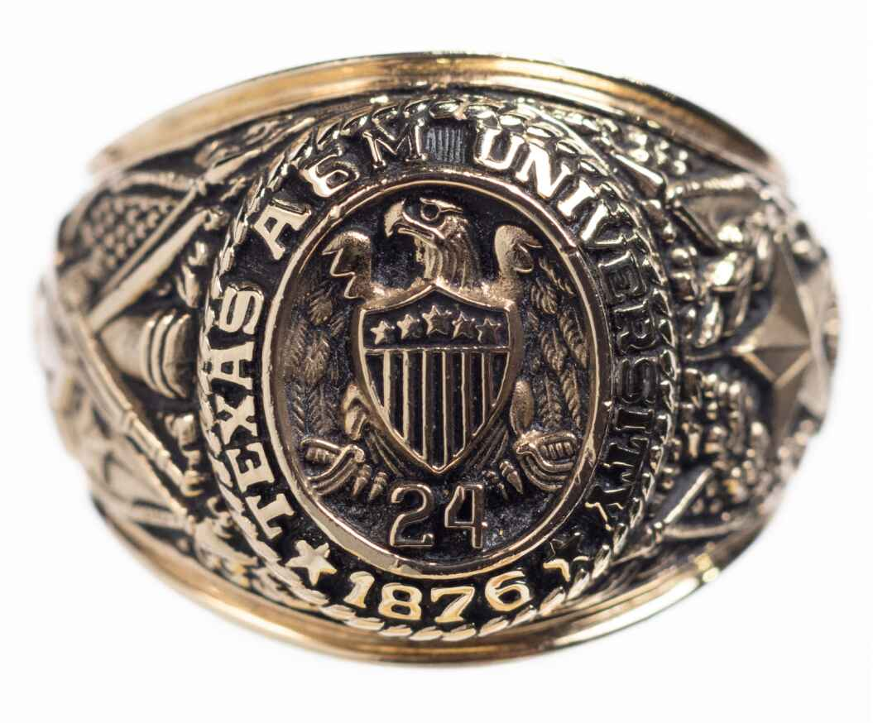
Guest Speaker
The Association of Former Students
Texas A & M
Ben Fisher, Coordinator of Campus Programs
Student Ambassadors

Slide 3
Approve Minutes
September 2025
https://cypress.aggiemoms.org
Club Meetings & Events
Member Resources

Slide 4


Slide 5
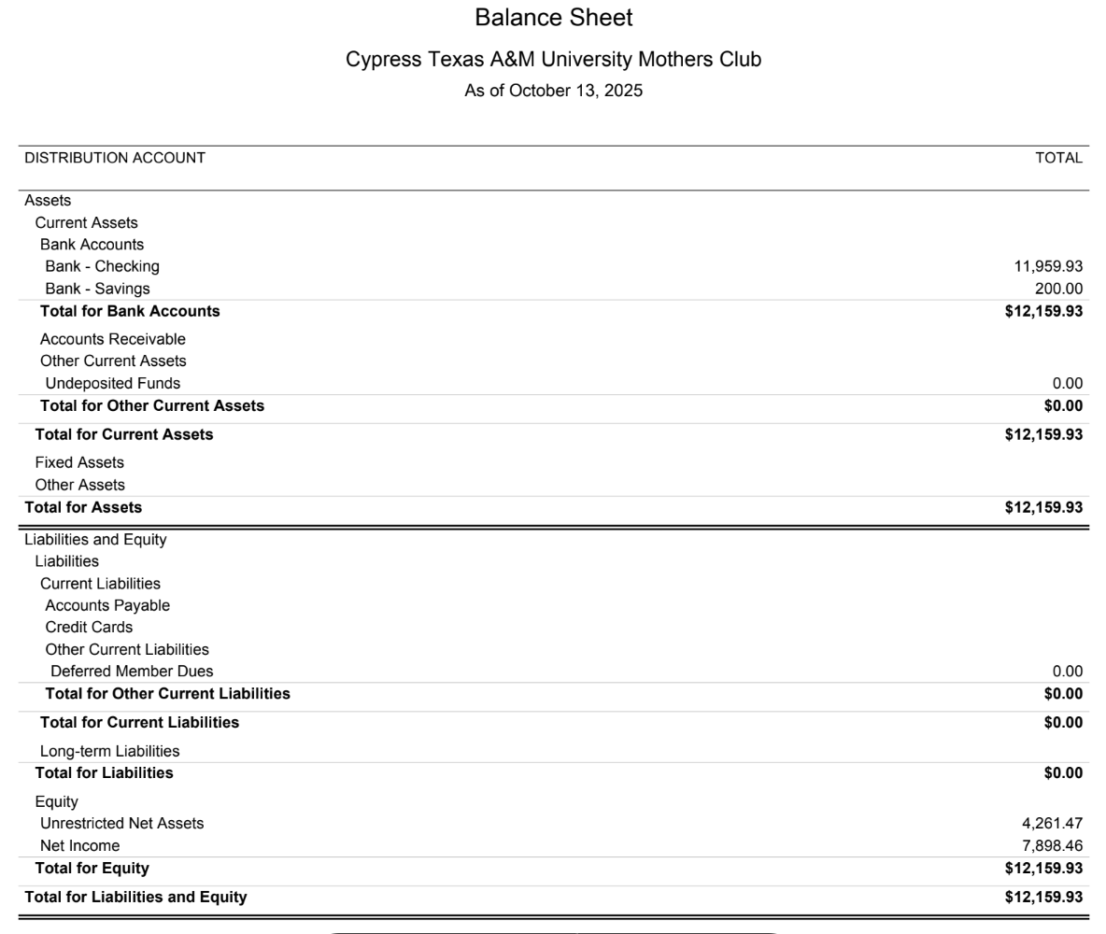

Slide 6
UPCOMING SOCIALS
October 23rd - Boos and Snack
November Dinner - November 6th
Cypress Trail Hideout

Slide 7


Slide 8


Slide 9


Slide 10

Aggie Moms Home Tailgates at Aggie Park
November 15th vs. South Carolina
November 22nd vs. Samford

Slide 11
Need Chairperson
Fundraising - businesses

Slide 12
UPCOMING MEETINGS
November 10
December 1
January 12

Slide 13

AGGIES SHARE
Good Bull
Prayer Requests
Mom Brags

Slide 14
Until next month
Federation of Texas A&M Mothers’ Clubs Facebook Group
Texas Aggie Mom’s Boutique on Facebook
Group Picture

