Slide 1

Cypress
Texas A&M University
Mothers’ Club
November 10, 2025 General Meeting

Slide 2

Guest Speaker
Sexual Assault Resource Center of Brazos Valley
Leiha White,
Director of Development and Outreach

Slide 3
Approve Minutes
October 2025
https://cypress.aggiemoms.org
Club Meetings & Events
Member Resources

Slide 4
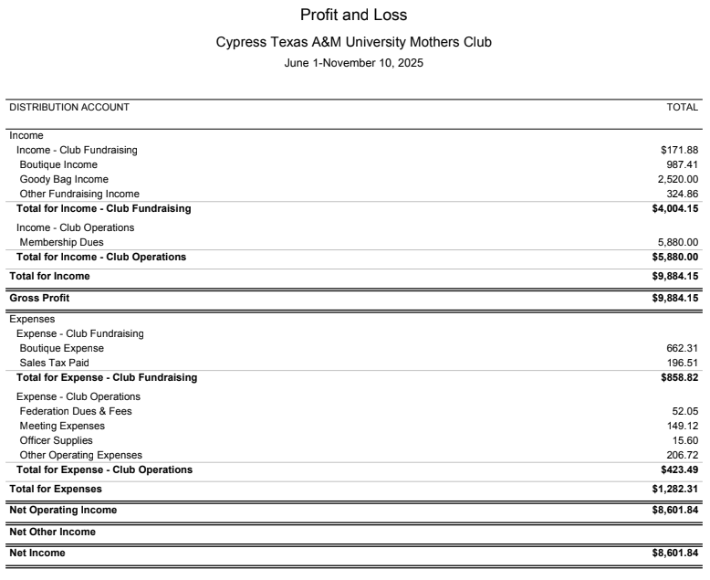
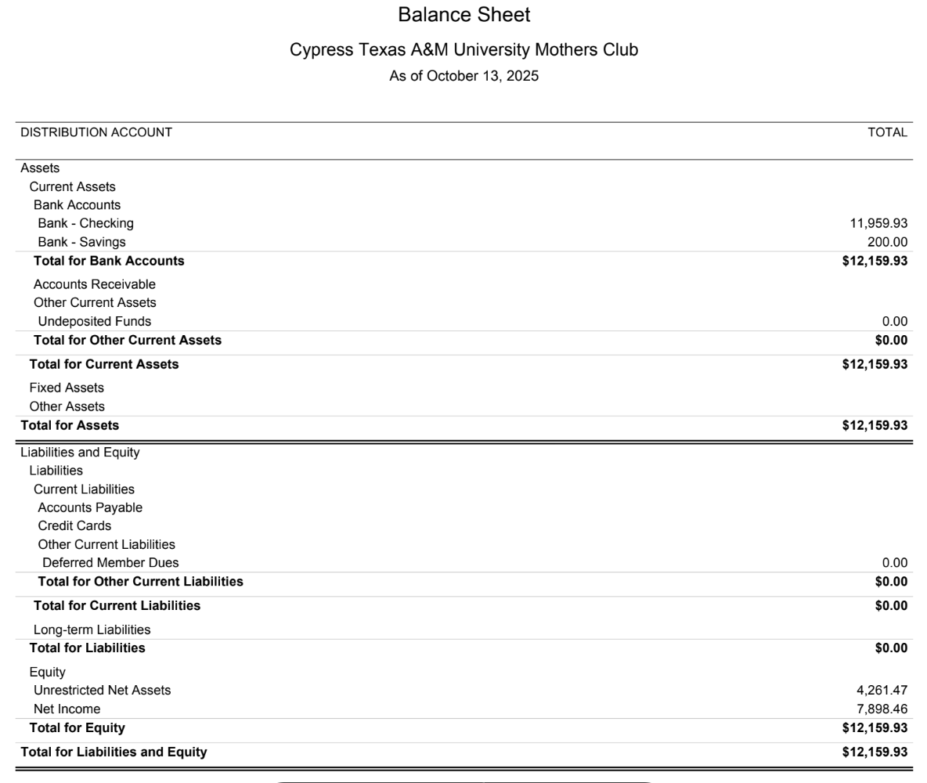

Slide 5
Income | Budget
Membership Dues | 6,000
Other Operating Income
Total | 6,000
Expenses | Budget
Federation Dues/Archive Fees $2.25ea | 338
President | 350
Membership | 200
Meetings - General | 2,250
Fundraising | 500
Treasurer | 550
VP at Large | 100
Historian | 100
Secretary | 100
Howdy Party | 749
Socials | 363
Other Operating Expenses | 400
Total | 6,000

Slide 6


Slide 7

https://www.signupgenius.com/go/70A044BA4AD23A57-59773855-fall?useFullSite=true#/

Slide 8
UPCOMING SOCIALS
November 12 - Floral Arranging Class (Full)
December Coffee Meet Up - TBD
Spring Co-Chair Requested

Slide 9
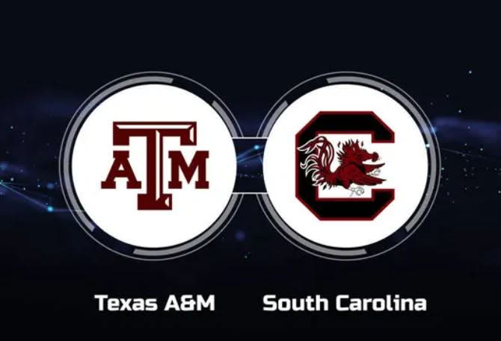

Aggie Moms Home Tailgates at Aggie Park
November 15th vs. South Carolina
              Tailgate Takeover - Watch Party!
November 22nd vs. Samford

Slide 10

https://orleans-home-fragrances-aggie-moms-candles.cheddarup.com

Slide 11

https://table.pamperedchef.com/party/2698706mhw

Slide 12


Slide 13
UPCOMING MEETINGS
December 1
January 12
February 9

Slide 14

AGGIES SHARE
Good Bull
Prayer Requests
Mom Brags

Slide 15
Until next month
Federation of Texas A&M Mothers’ Clubs Facebook Group
Texas Aggie Mom’s Boutique on Facebook
Group Picture

Slide 16


