Slide 1

Cypress Texas A&M University
Mothers’ Club
December 1, 2025 General Meeting

Slide 2
Approve Minutes
November 2025
https://cypress.aggiemoms.org
Club Meetings & Events
Member Resources

Slide 3
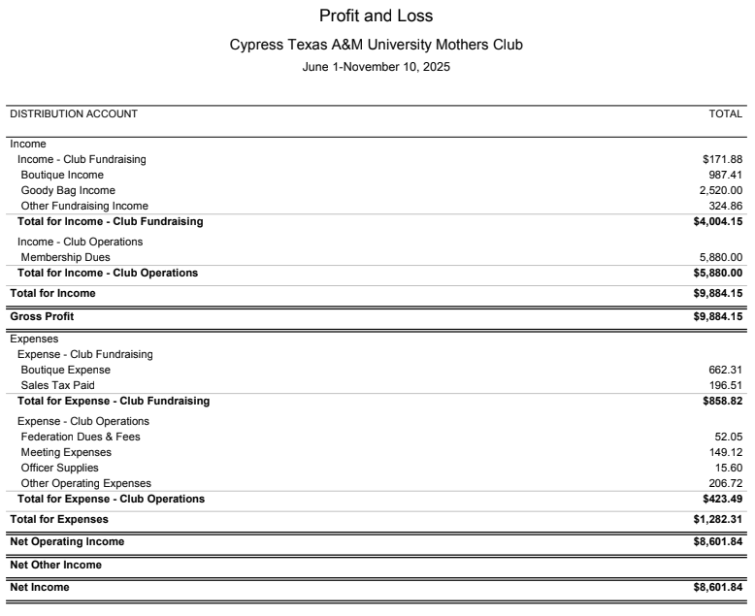
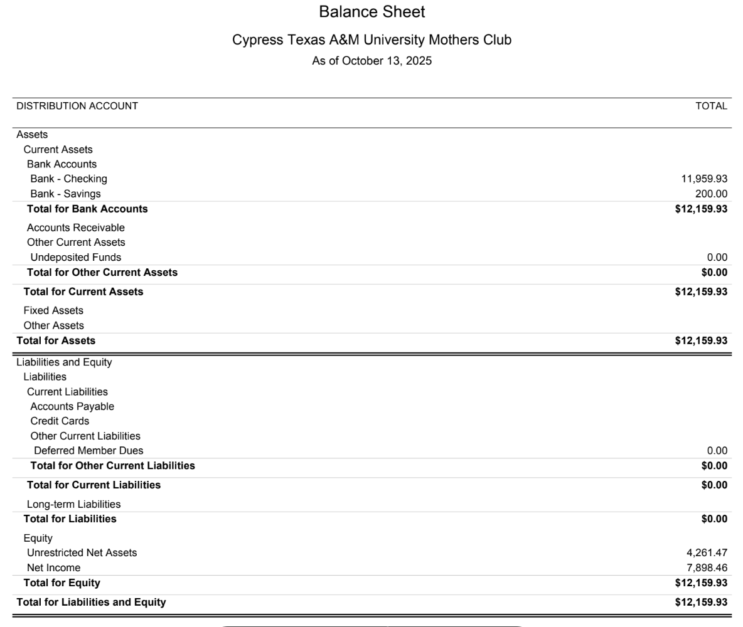

Slide 4


Slide 5

https://www.signupgenius.com/go/70A044BA4AD23A57-59773855-fall?useFullSite=true#/

Slide 6
UPCOMING SOCIALS
November 12 - Floral Arranging Class (Full)
December Coffee Meet Up - TBD
Spring Co-Chair Requested

Slide 7
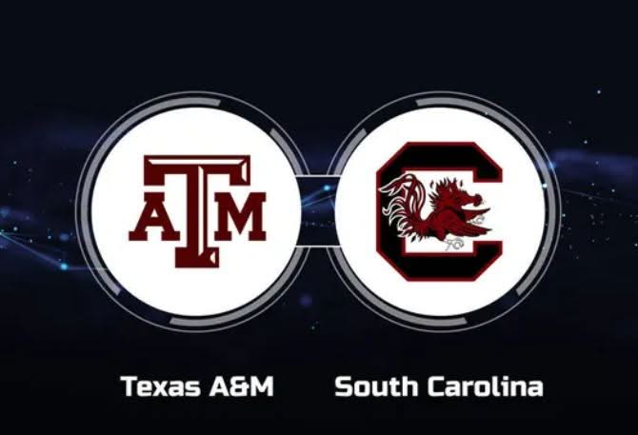

Aggie Moms Home Tailgates at Aggie Park
November 15th vs. South Carolina
Tailgate Takeover - Watch Party!
November 22nd vs. Samford

Slide 8

https://orleans-home-fragrances-aggie-moms-candles.cheddarup.com

Slide 9

https://table.pamperedchef.com/party/2698706mhw

Slide 10


Slide 11
UPCOMING MEETINGS
December 1
January 12
February 9

Slide 12

AGGIES SHARE
Good Bull
Prayer Requests
Mom Brags

Slide 13
Until next month
Federation of Texas A&M Mothers’ Clubs Facebook Group
Texas Aggie Mom’s Boutique on Facebook
Group Picture

Slide 14


