Slide 1

Cypress Texas A&M University
Mothers’ Club
January 12, 2026 General Meeting

Slide 2
Approve Minutes
December 2025
https://cypress.aggiemoms.org
Club Meetings & Events
Member Resources

Slide 3

Guest Speakers
Aggie Achievemates
Zoom Call -
McCall, Heather & Marco
https://www.instagram.com/aggieachievemates/

Slide 4

https://orleans-home-fragrances-aggie-moms-candles.cheddarup.com

Slide 5


Slide 6


Slide 7


Slide 8
Board Reports

Slide 9
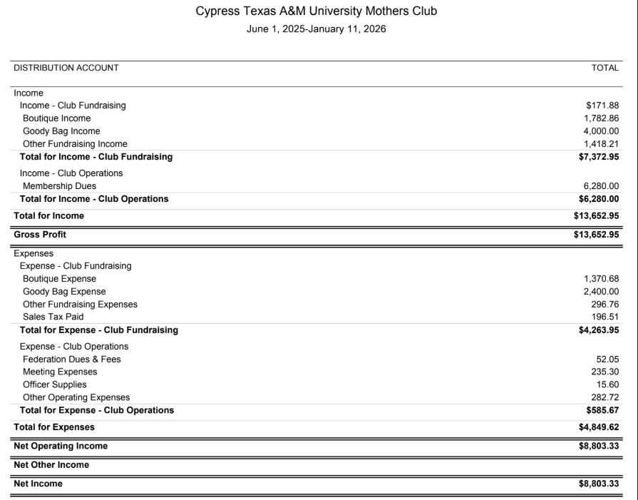

Slide 10


Slide 11
UPCOMING MEETINGS
February 9 - Fighting Texas Aggie Band
12 Fire Wines
Apple delivery
March 16 - Patriot Paws of Aggieland
St. Patrick’s Day celebration
Aggie Mom 2026-2027 Elections
April 13 - Career Center

Slide 12

AGGIES SHARE
Good Bull
Prayer Requests
Mom Brags

Slide 13
Until next month
Federation of Texas A&M Mothers’ Clubs Facebook Group
Texas Aggie Mom’s Boutique on Facebook
Group Picture

Slide 14


