Slide 1

Cypress
Texas A&M University
Mothers’ Club
February 9, 2026 General Meeting

Slide 2
Approve Minutes
January 2026
https://cypress.aggiemoms.org
Club Meetings & Events
Member Resources

Slide 3

https://orleans-home-fragrances-aggie-moms-candles.cheddarup.com

Slide 4

Caramel Apple
Fundraiser Pick Up
** Don’t forget your apples

Slide 5
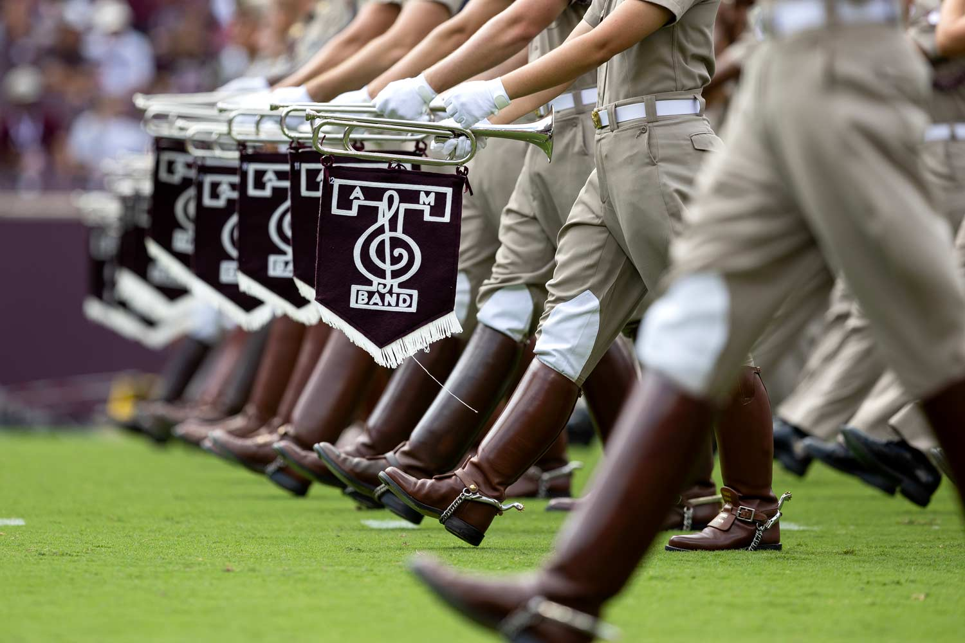
Guest Speakers
Fighting Texas Aggie Band
Zoom Call
https://www.instagram.com/aggieachievemates/

Slide 6
Board Reports

Slide 7

Aggie Moms & Dads Social
Sunday, March 1st
Wildflyer Mead & Beer
16481 County Road 319
Navasota, TX 77868
Aggie Moms bring your husbands
Family friendly environment
Have your Aggie meet you there

Slide 8


Slide 9


Slide 10
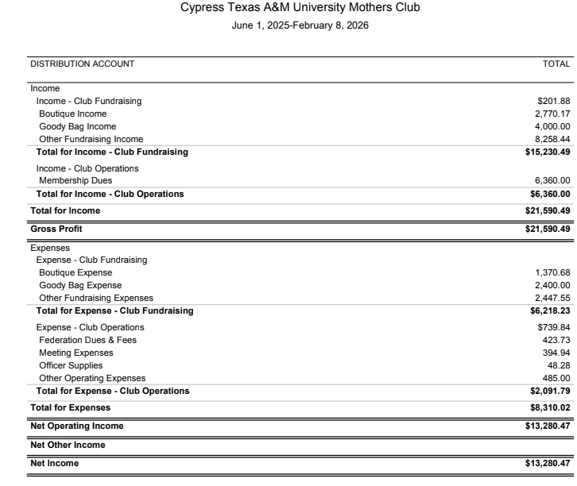

Slide 11
UPCOMING MEETINGS
March 16 - Career Center/Career Closet
St. Patrick’s Day celebration
Aggie Mom 2026-2027 Elections
April 13 - Patriot Paws of Aggieland
Wildflyer Mead & Beer
May 4 - Scholarship Awards
2026 - 2027 Board

Slide 12

AGGIES SHARE
Good Bull
Prayer Requests
Mom Brags

Slide 13
Until next month
Federation of Texas A&M Mothers’ Clubs Facebook Group
Texas Aggie Mom’s Boutique on Facebook
Group Picture

Slide 14


