Slide 1


Cypress Texas A&M University
Mothers’ Club
WiFi: ABCGuestWiFi
Anteater@11934
March 16, 2026 General Meeting

Slide 2
Approve Minutes
February 2026
https://cypress.aggiemoms.org
Club Meetings & Events
Resources

Slide 3

Guest Speaker
Texas A & M Career Center
Paul Pausky ‘78

Slide 4
2026-2027 Board Elections
President - Kelly Breland
President Elect - Tara McKenna
VP at Large - Cindy King
1st VP Membership - Betsy Moore
2nd VP Meetings - open
3rd VP Boutique - Jessi Merlo
Board Treasurer - Glenda Ensley
Secretary - open

Slide 5
Board Reports

Slide 6
Fundraising
 |  | Profit
Tshirt sales w/CC Creations | Aug 25 | $171.88
Angela Decorates profit share | July 25 | $190.00
Kendra Scott profit share | Sep 25 | $33.00
Pumpkin Bread | Nov 25 | $261.54
Sweatshirts | Nov 25 | $256.29
Ornaments | Dec 25 | $279.08
Capps 3D profit share | Dec 25 | $102.00
Candles | Dec 25 | $145.14
Boutique | Fall 25 | $813.02
Goody Bags | Oct 25 | $1,295.00
Pampered Chef | Nov 25 | $186.27
Big Hearts | Jan 25 | $4,500.00
Munchoes Apples | Feb 25 | $486.00
12 Fires Winery | Feb 25 | $152.00
Spring Boutique | Apr 25
Goody Bags | Apr 25
Wildflyer Mead | Apr 25
May Silent Auction | May 25
 |  | $8,871.22

Slide 7
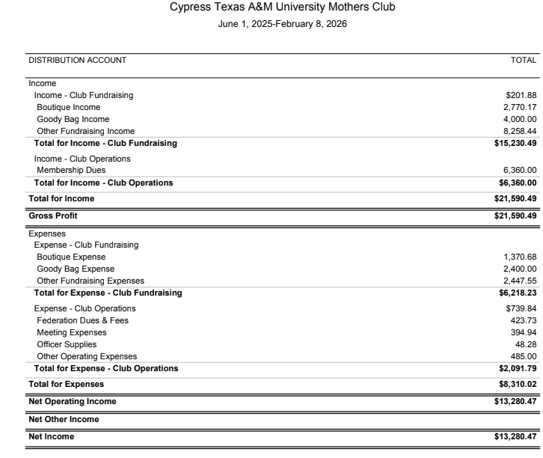

Slide 8

Aggie Mom Boutique
MSC - 2nd Floor
Friday, April 10th
10:00 - 4:30
Saturday, April 11th
10:00 - 4:00

Slide 9
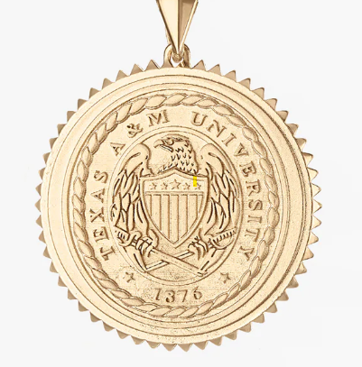
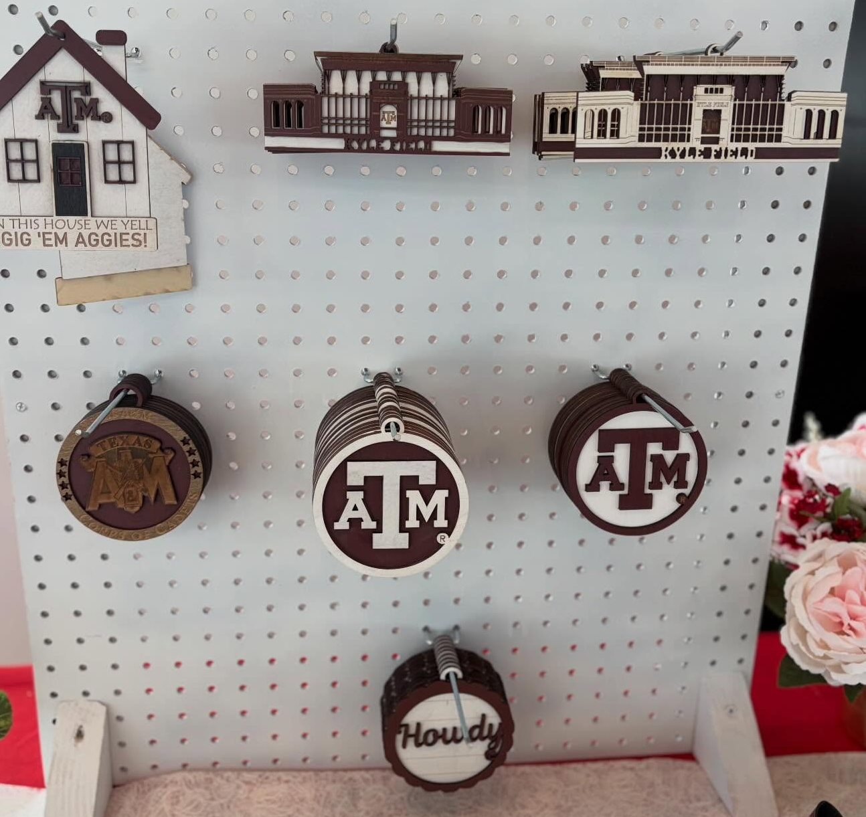
Aggie Mom Boutique
Kyle Cavan Jewelers
Etched in Time Creations

Slide 10
UPCOMING EVENTS
March 26 - Singo Bingo
The Barn @ Frio Grill
April 10 thru 12 - Family Weekend
April 10 - 11 - Aggie Mom Boutique

Slide 11


Slide 12
UPCOMING MEETINGS
April 13 - Patriot Paws of Aggieland
Wildflyer Mead & Beer
May 4 - Scholarship Awards
2026 - 2027 Board

Slide 13

AGGIES SHARE
Good Bull
Prayer Requests
Mom Brags

Slide 14
Until next month
Federation of Texas A&M Mothers’ Clubs Facebook Group
Texas Aggie Mom’s Boutique on Facebook
Group Picture

Slide 15


