Slide 1


Slide 2


Cypress
Texas A&M University
Mothers’ Club
WiFi: ABCGuestWiFi
Anteater@11934
May 4, 2026 General Meeting

Slide 3
Approve Minutes
April 2026
https://cypress.aggiemoms.org
Club Meetings & Events
Resources

Slide 4
Board Reports

Slide 5

Membership
26-27 Membership Drive Now Open
-54 Currently Registered
Past Membership Counts
25/26 167
24/25 125
23/24 49
Moms of TAMU College Station, Galveston, & McAllen, Blinn TEAM/TEAB & Engineering Academies

Slide 6
Maroon Legacy Circle
Recognizes members with 4 consecutive years of service
Inaugural Class will be honored in May 2027
Eligible Members:
Amy Bennett Elizabeth Farrell Amy Wilkes
Tonya Keneda Heather LaFleur Michelle Sutherland
Jessi Merlo Kellyann Nelsen Rachel Roffall
Jenny Brooks Joyce Chiasson Carrie DeLancey
Pepper Edwards Kimberly Gerrard Kathy Grahmann
Jacque Hardy Heidi Hensley Deanna Hicks
Lisa Lee Krista Liller Kelli Maddox
Maryann Mason Kirsten McFarland Comfort Miller
Carey Roberton April Selby Julie Swoboda

Slide 7
Fundraising
 |  | Profit
Tshirt sales w/CC Creations | Aug 25 | $171
Angela Decorates profit share | July 25 | $190
Kendra Scott profit share | Sep 25 | $33
Pumpkin Bread | Nov 25 | $261
Sweatshirts | Nov 25 | $256
Ornaments | Dec 25 | $279
Capps 3D profit share | Dec 25 | $102
Candles | Dec 25 | $145
Boutique | Fall 25 | $1,018
Goody Bags | Oct 25 | $1,295
Pampered Chef | Nov 25 | $186
Big Hearts | Jan 25 | $9,000
Munchoes Apples | Feb 25 | $486
12 Fires Winery | Feb 25 | $152
Family Weekend Boutique | Apr 25 | $3,000
Goody Bags | Apr 25 | $1,317
Wildflyer Mead | Apr 25
May Silent Auction | May 25
 |  | $17,891

Slide 8
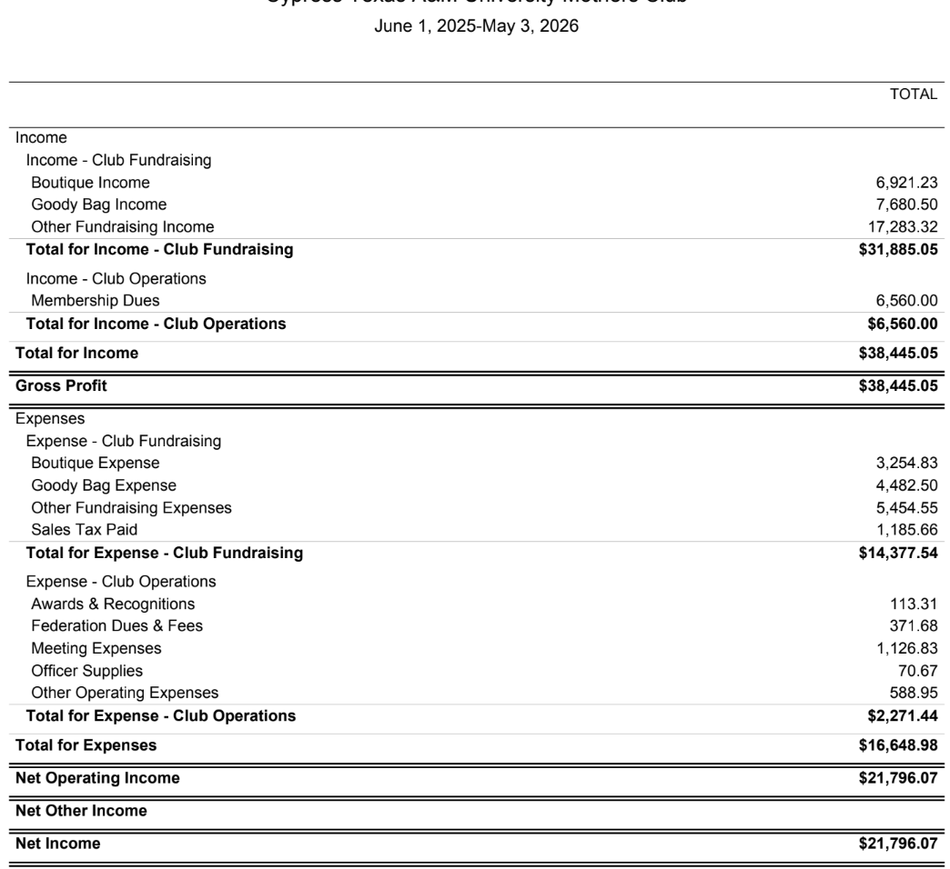

Slide 9
Motion to Donate to Student Orgs
Whereas Net Income is $21,796, $6,000 donation to endowment and $11,000 in scholarships leaves $4,796 for the year, and given our mission of supporting students at Texas A&M, I move that we donate a total of $2,750 to the following organizations:
–Traditions Council $350 –Association $350
–SARC $350 –AchieveMates $350
–TAMU Band $350 –Career Closet $350
–Career Center $300 –Patriot Paws $350

Slide 10
2025-2026
Scholarship
Recipients

Slide 11
Sean
Carter

Slide 12
Parker
Christ

Slide 13
Dillon
Crozier

Slide 14
Molly
Fitzpatrick

Slide 15
Nathan
Francis

Slide 16
Kris
Kafle

Slide 17
Camden
Maddox

Slide 18
Braden
Nott

Slide 19
Jorge
Ortez

Slide 20
Shayla
Randle

Slide 21
Tyler
Wilkes

Slide 22


Slide 23
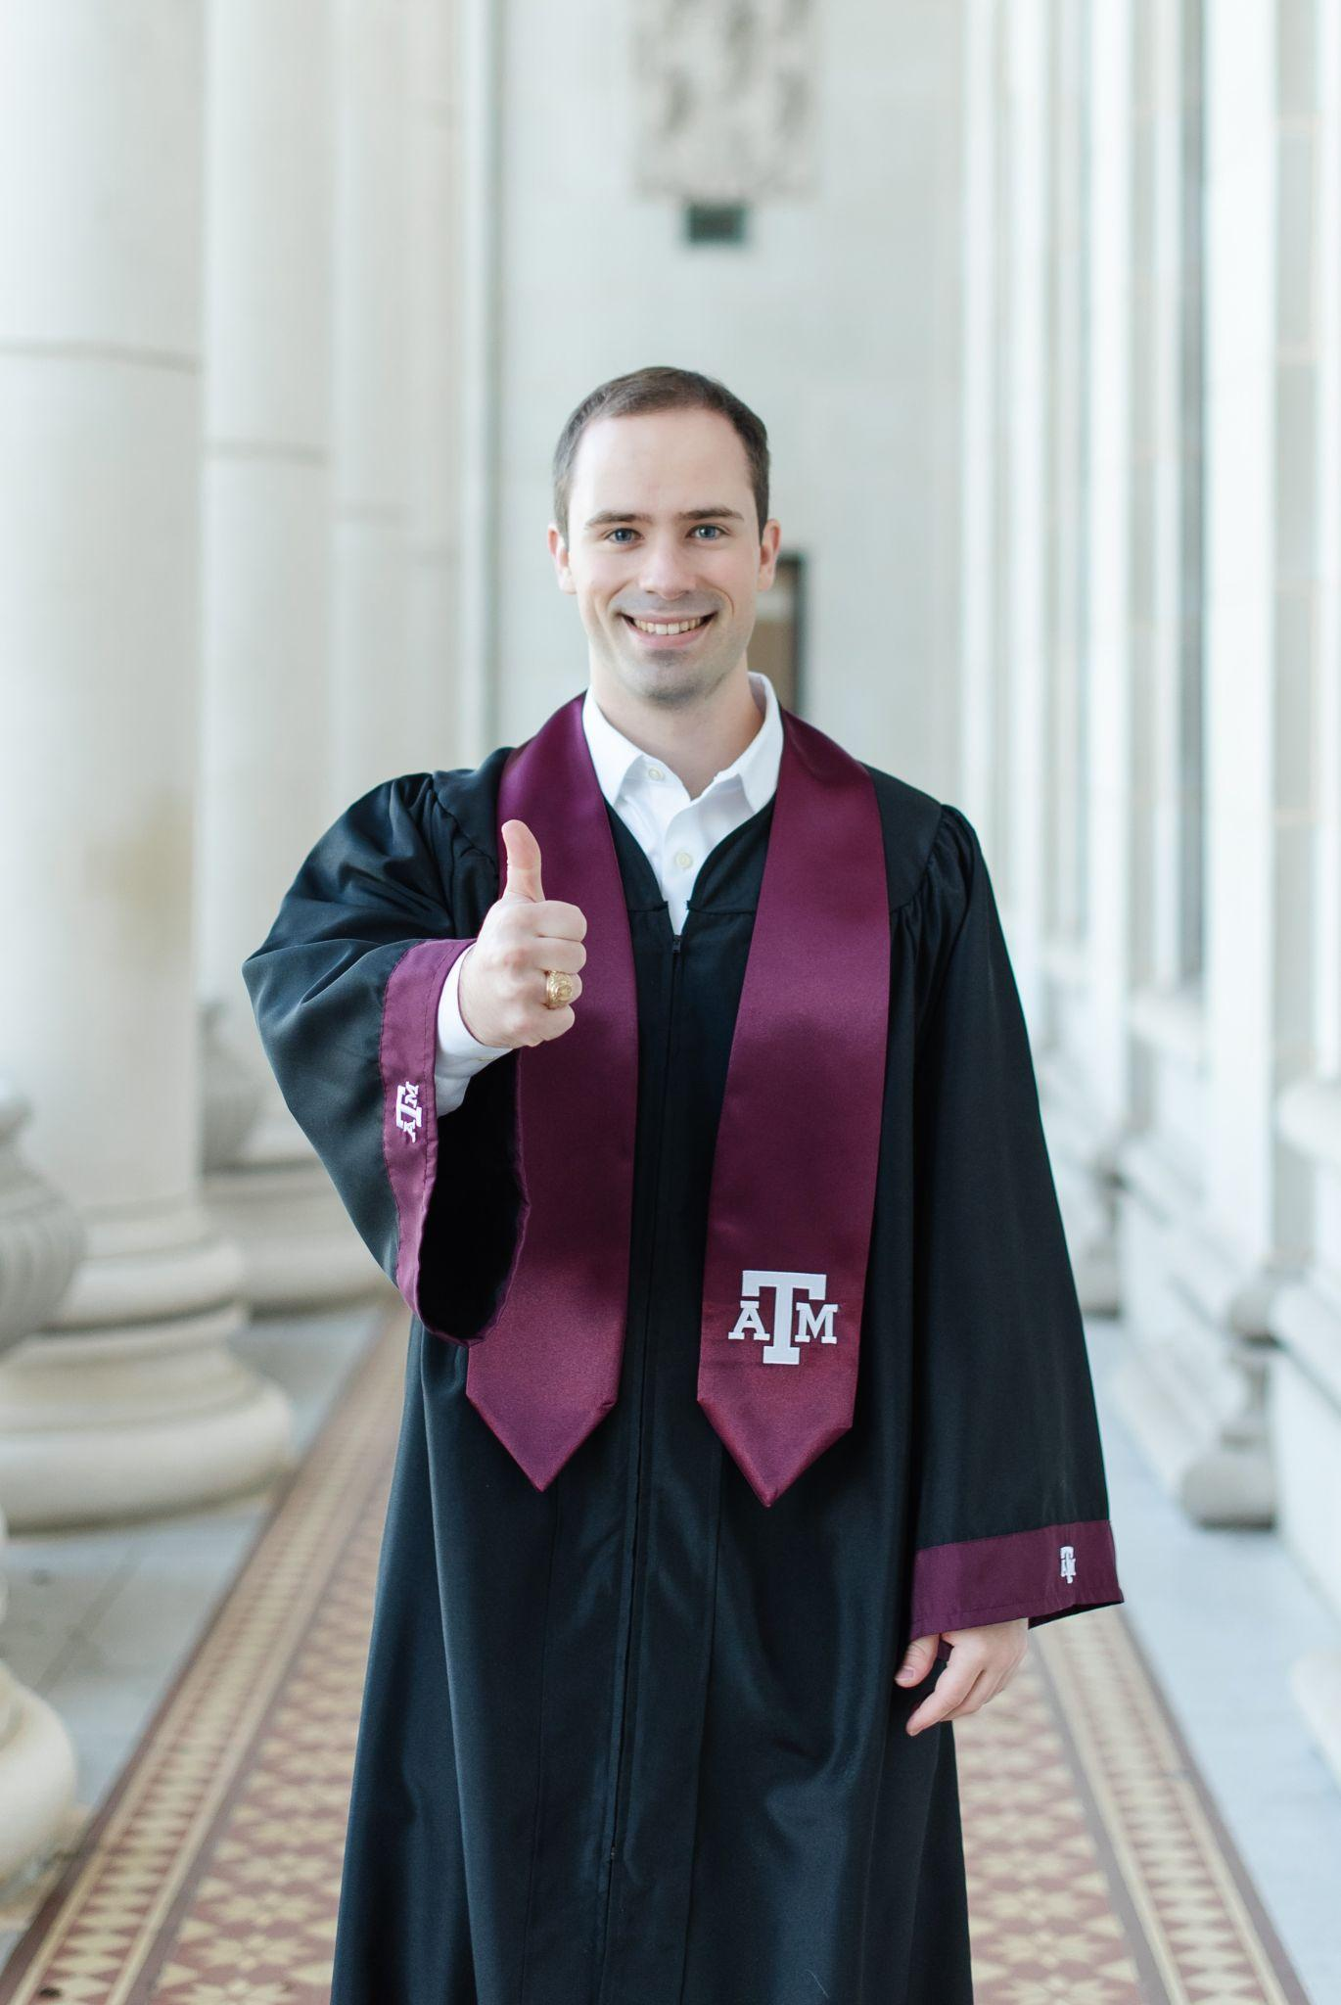
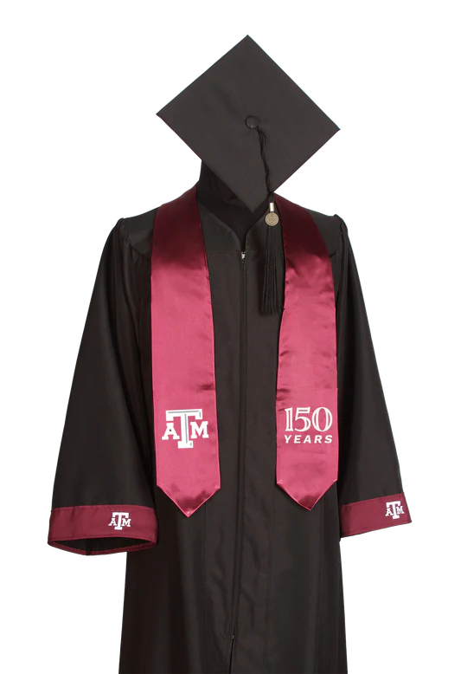
Bryant Brooks
Graduate:
December 2025
Computer Engineering
Mom: Jenny Brooks

Slide 24
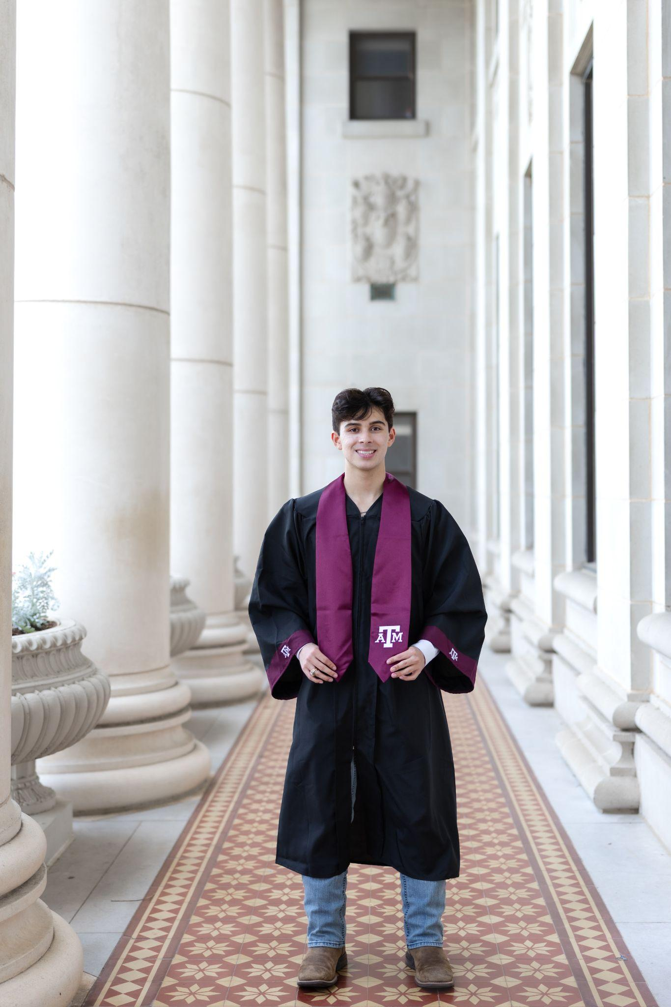
Ryan Carter
Graduate:
May 2026
Political Science
Mom: Kimberly Gerrard

Slide 25
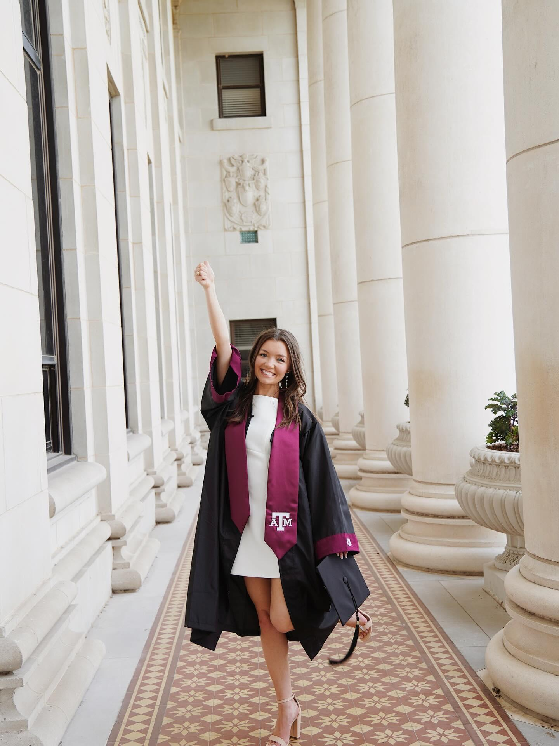
Camryn Cobb
Graduate:
May 2026
Aerospace Engineering
Mom: Salli

Slide 26
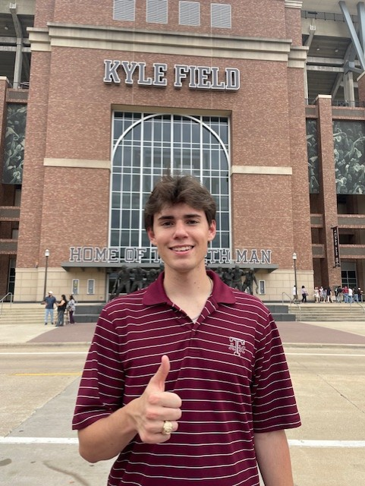
Luke DeLancey
Graduate:
May 2026
Electrical Engineering
Mom: Carrie DeLancey

Slide 27
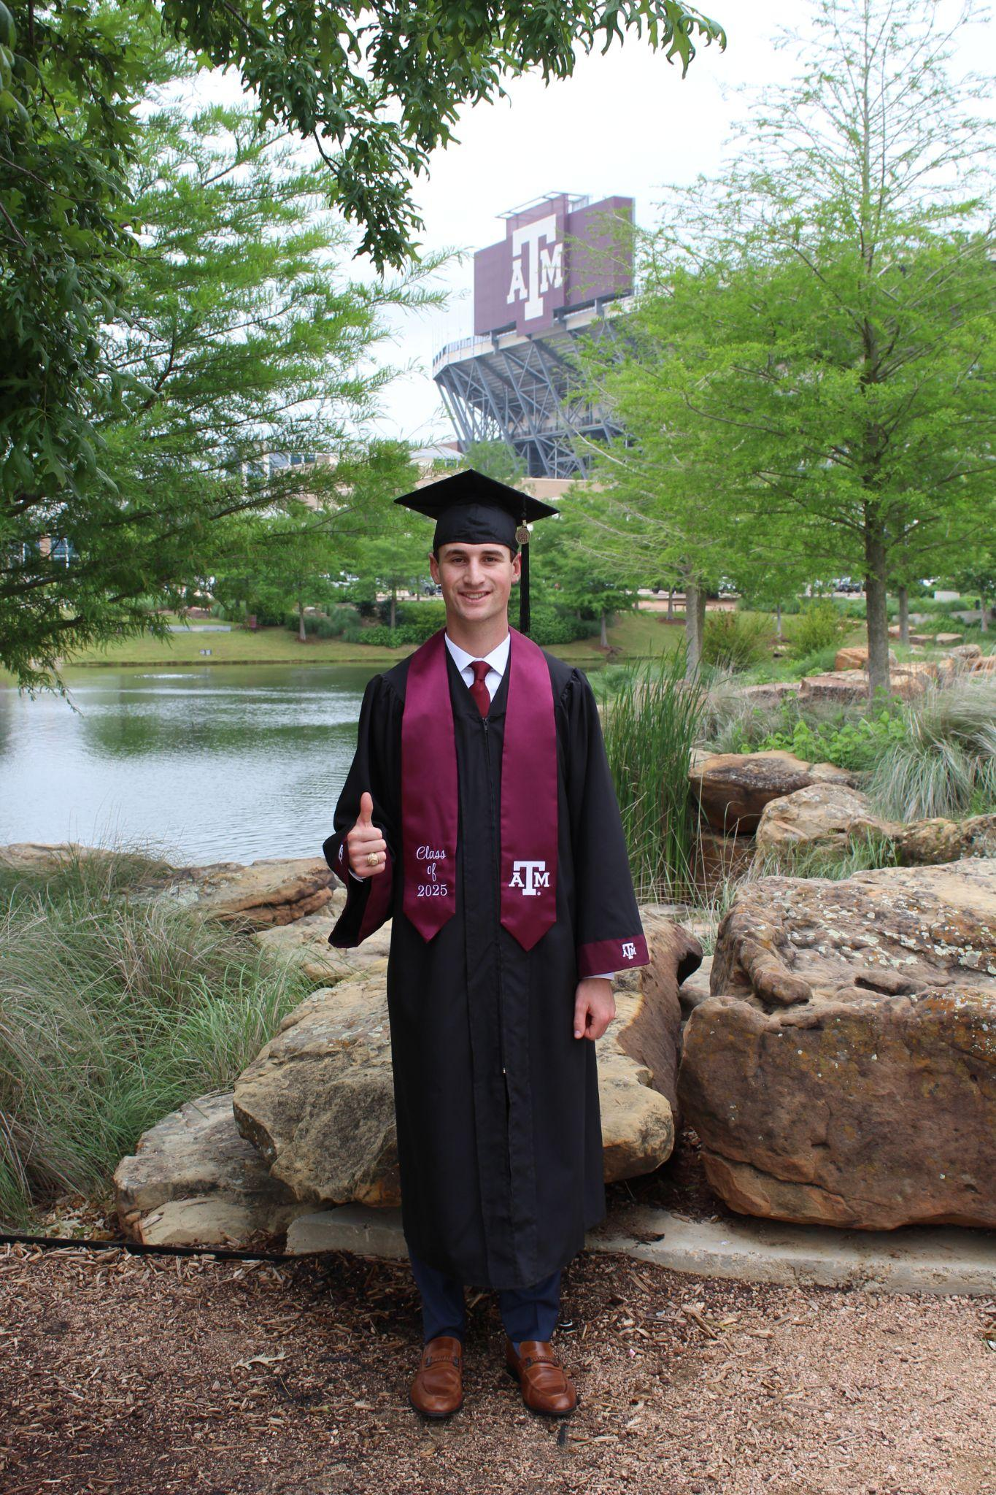
Kyle Dickey
Graduate:
May 2026
Ocean Engineering
Mom: Diane Dickey

Slide 28
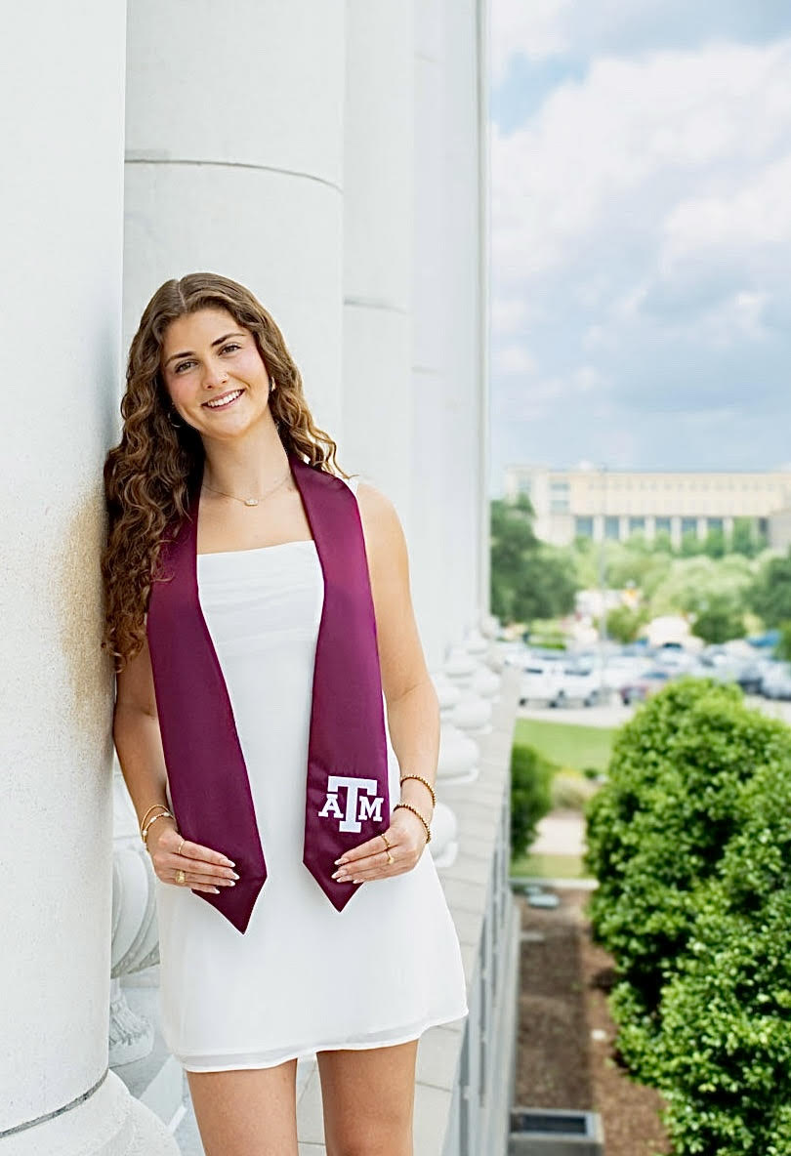
Brooke Hensley
Graduate:
May 2026
Kinesiology
Mom: Heidi Hensley

Slide 29

Kaitlyn Keneda
Graduate:
May 2026
Mechanical Engineering
Mom: Tonya Keneda

Slide 30
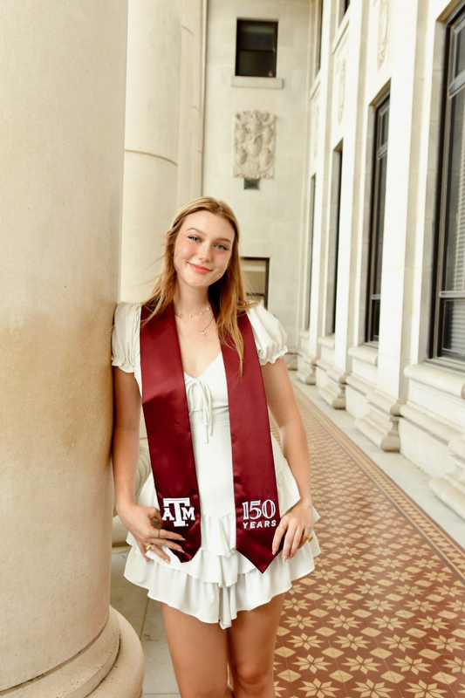
Reagan Leitner
Graduate:
May 2026
Forensic & Investigative Sciences
Mom: Marie Leitner

Slide 31
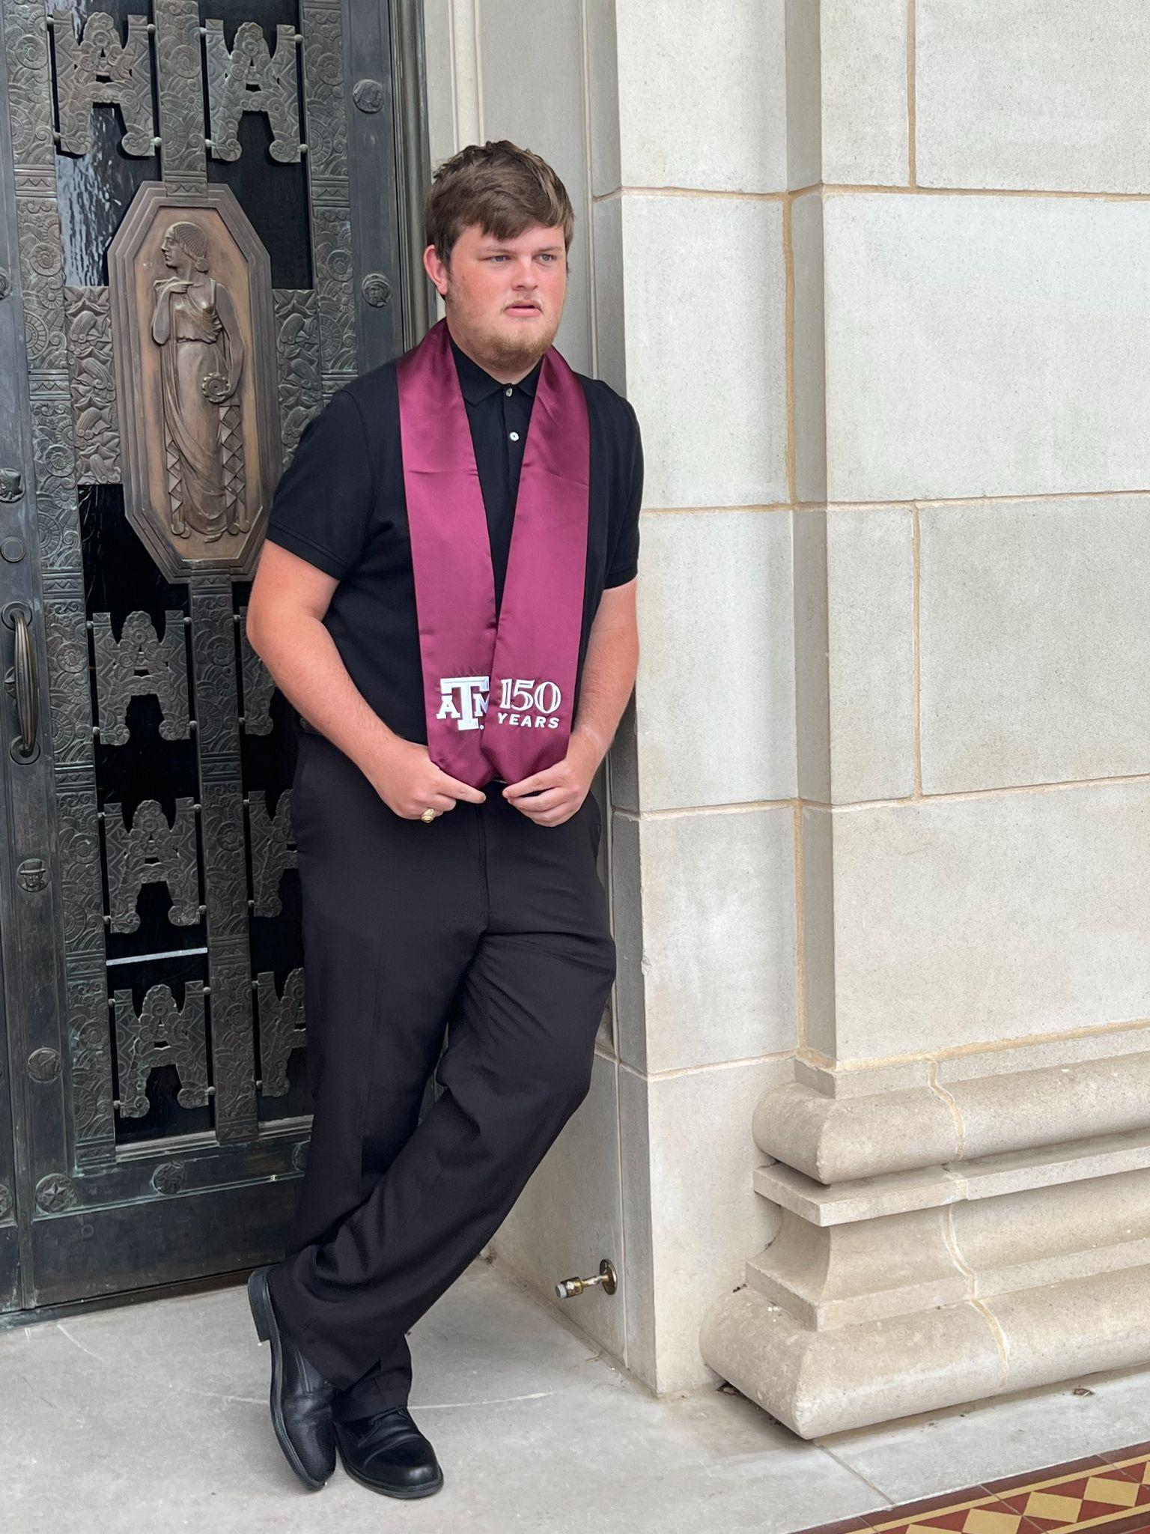
Kyle Rich
Graduate:
May 2026
Mechanical Engineering
Mom: Cher Rich

Slide 32
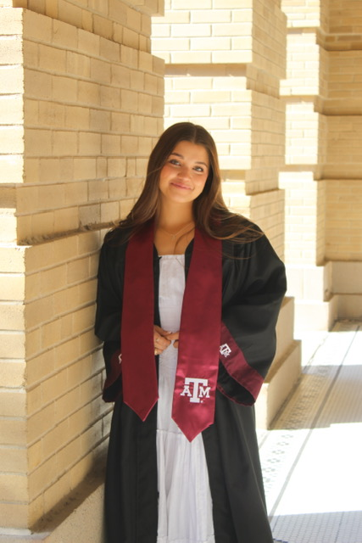
Jordan Selby
Graduate:
May 2026
Public Health
Mom: April Selby

Slide 33
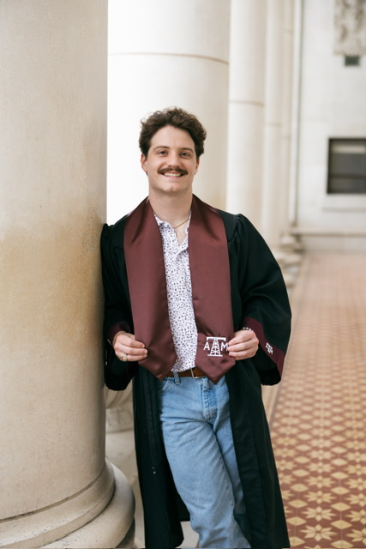
Jacob Shiflett
Graduate:
May 2026
Petroleum Engineering
Mom: Kerry Shiflett

Slide 34
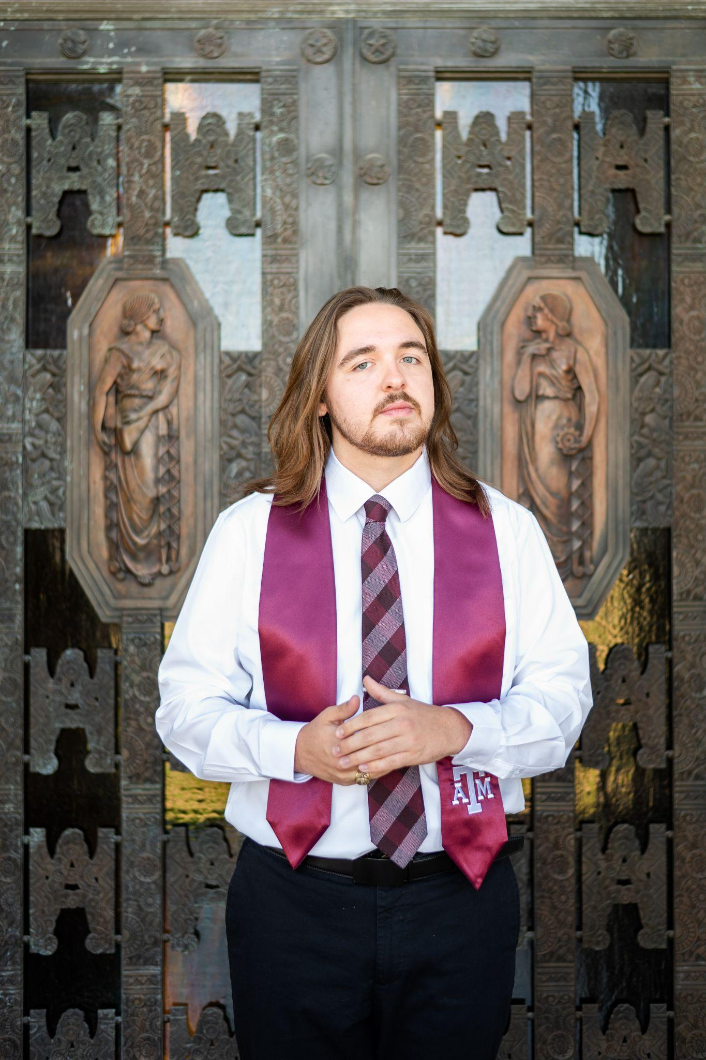
Jackson Swoboda
Graduate:
May 2026
Zoology
Mom: Julie Swoboda

Slide 35
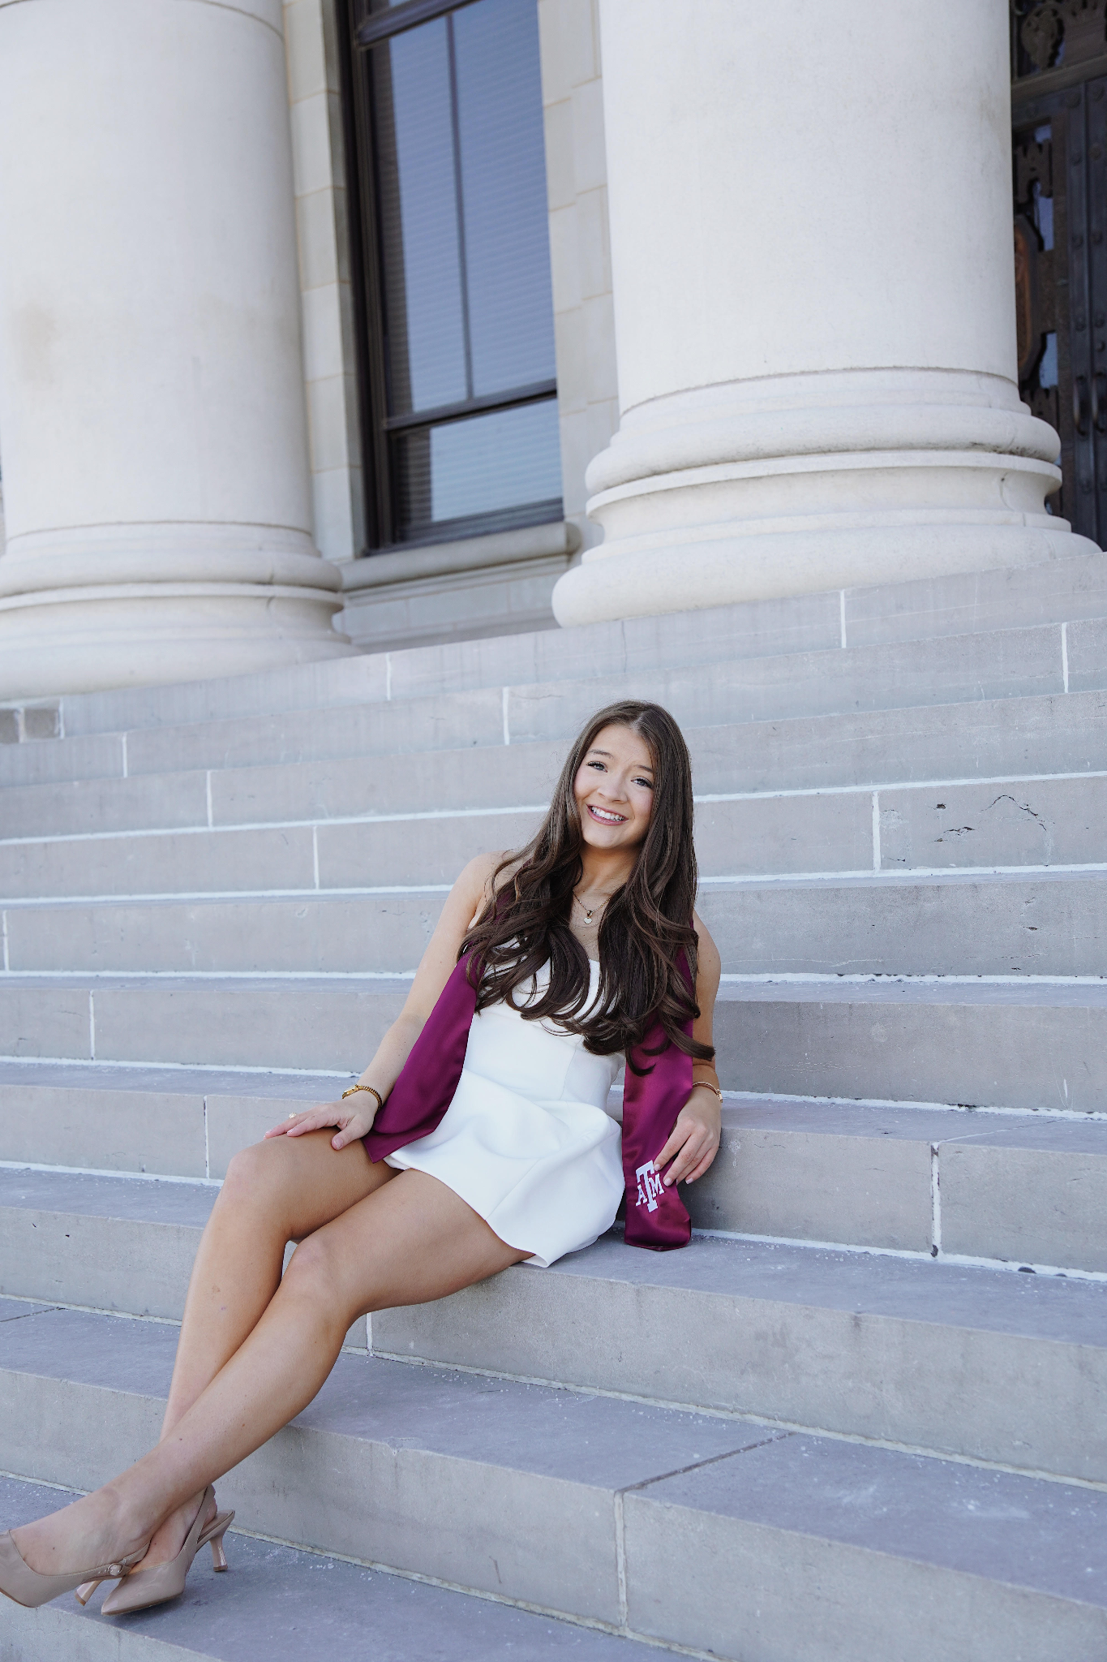
Alexis Womack
Graduate:
May 2026
Education
Mom: Robin Womack

Slide 36
Summer Socials
June
Thurs, June 4 - Paint ‘n’ Sip
-Frio
Wed, June 10 - Lunch
-The Bake Shoppe
Tues, June 16 - Dinner
-TBD

Slide 37
Summer Socials
July
Wed, July 8 - Lunch
-Local Table
Sat, July 18 - Howdy Party
-ABC
Thurs, July 30 - Dinner
-D’Vine Wine

Slide 38
Summer Socials
August
Tues, Aug 4 - Cooking Class -Cookin’ with Kim
Wed, Aug 12 - Lunch
-The Farmer’s Table
Mon, Aug 24 - First Day of Class
-LaViva Cantina

Slide 39
2026-2027
Board Induction

Slide 40
UPCOMING MEETINGS
September 14 - First Meeting
2026 - 2027

Slide 41

AGGIES SHARE
Good Bull
Prayer Requests
Mom Brags

Slide 42
Until July ….
Federation of Texas A&M Mothers’ Clubs Facebook Group
Texas Aggie Mom’s Boutique on Facebook
Group Picture

Slide 43


